Slide 1


Master of Science (Computer Science) Sub. Code: COMS 411 Sub. Name: Design of Algorithms
Dr. S. RAVI, Dept. of Computer Science

Slide 2
Definition of Algorithm
The word Algorithm comes from the name of the Persian author, Abu Jafar Mohammed ibn Musa al Khowarishmi (c. 825 A.D).
Al-Khowarizmi meaning from the town of Khowarasm, city is now known as Khiva and located in Uzbekistan, USSR.
Algorism – algorithm.
Any special method of solving a certain kind of problem. (Webster’s dictionary)
Algorithm is composed of a finite set of steps, each of which may require one or more operations.

Slide 3
Problem Solving: Main Steps
Problem definition
Algorithm design / Algorithm specification
Algorithm analysis
Implementation
Testing
[Maintenance]

Slide 4
1. Problem Definition
What is the task to be accomplished?
Calculate the average of the grades for a given student
Understand the talks given out by politicians and translate them in Chinese
What are the time / space / speed / performance requirements ?

Slide 5
2. Algorithm Design / Specifications
Algorithm: Finite set of instructions that, if followed, accomplishes a particular task.
Describe: in natural language / pseudo-code / diagrams / etc.
Criteria to follow:
Input: Zero or more quantities (externally produced)
Output: One or more quantities
Definiteness: Clarity, precision of each instruction
Finiteness: The algorithm has to stop after a finite (may be very large) number of steps
Effectiveness: Each instruction has to be basic enough and feasible
Understand speech
Translate to Chinese

Slide 6
Computer Algorithms
An algorithm is a procedure (a finite set of well-defined instructions) for accomplishing some tasks which,
given an initial state
terminate in a defined end-state
The computational complexity and efficient implementation of the algorithm are important in computing, and this depends on suitable data structures.

Slide 7
4,5,6: Implementation, Testing, Maintainance
Implementation
Decide on the programming language to use
C, C++, Lisp, Java, Perl, Prolog, assembly, etc. , etc.
Write clean, well documented code
Test, test, test
Integrate feedback from users, fix bugs, ensure compatibility across different versions → Maintenance

Slide 8
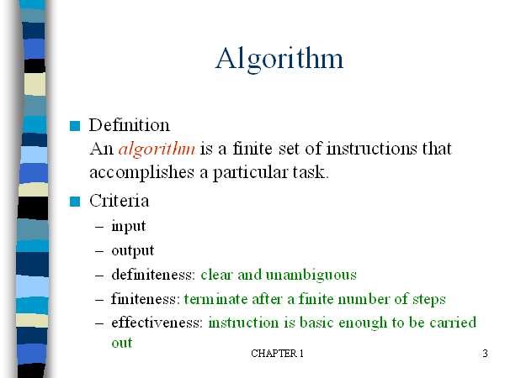
- Zero or more quantities should be externally supplied
-At least one quantity is produced
by a person using only pencil and paper

Slide 9
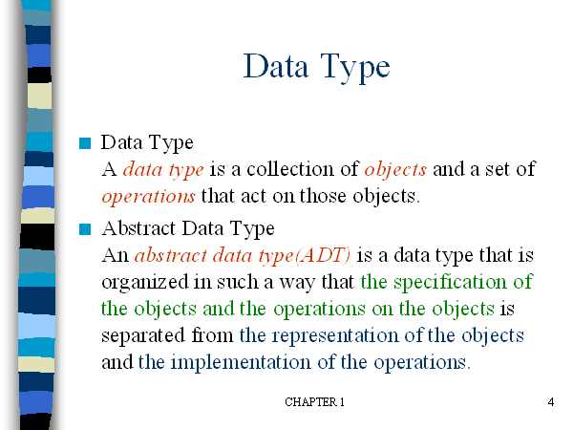

Slide 10
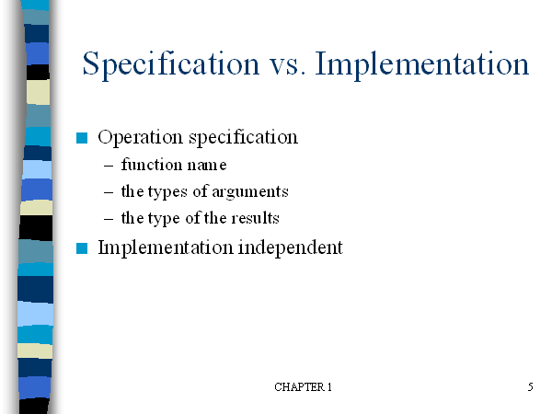

Slide 11
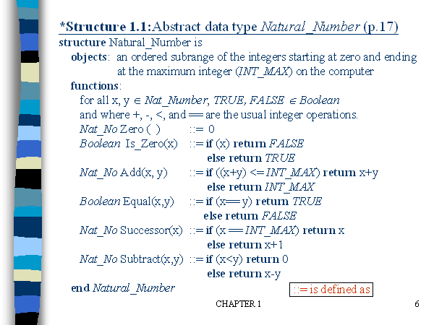

Slide 12
How to create programs
Seat of pants method: Write something down and then try to get it working.
The process of creating programs is split into five phases:
i) Requirements: Understand the information given (the inputs) and what results U R to produce (the outputs)
ii) Design: For each object there will be some basic opns to perform on it.
Write an algorithm which solves the problem.
iii) Analysis: Write more than one algorithm. Compare them and choose the best algorithm.
iv) Refinement and coding:
v) Verification: Consists of three distinct aspects:
Program proving: Prove that the program is correct for all possible combination of inputs.
Testing: The art of creating sample data upon which to run UR program.
Debugging: The process of correcting errors

Slide 13


Slide 14
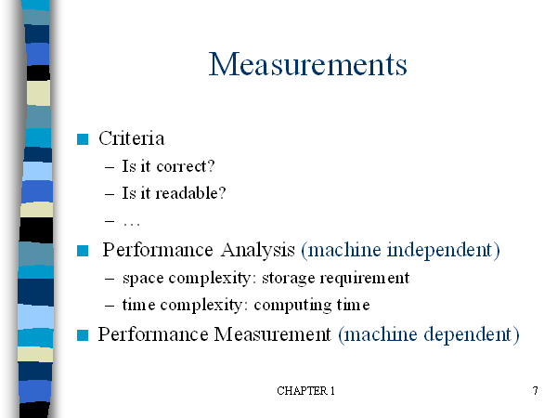

Slide 15
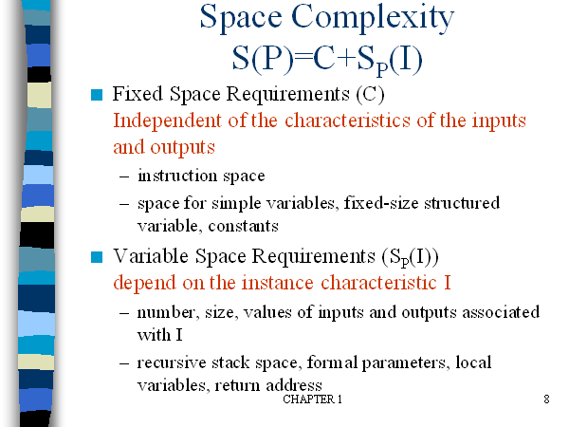

Slide 16
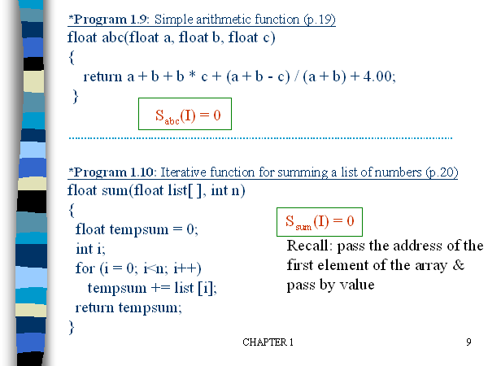

Slide 17
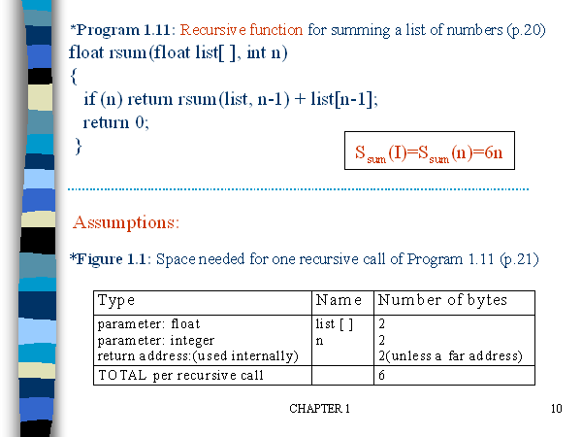

Slide 18
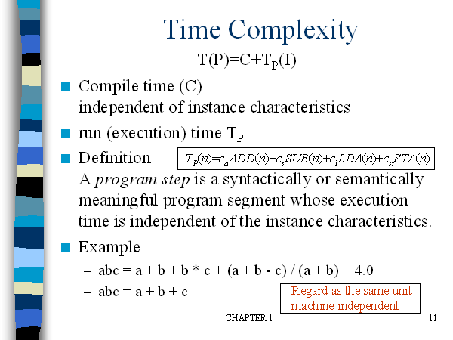

Slide 19
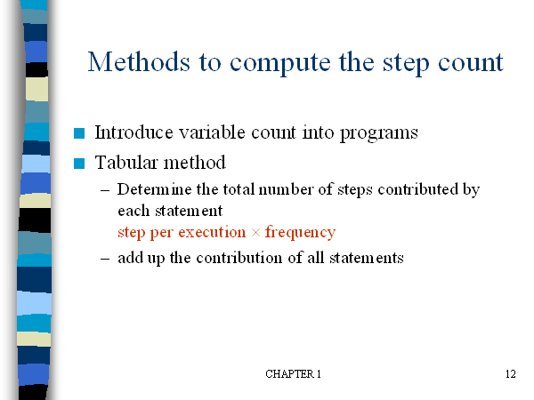

Slide 20
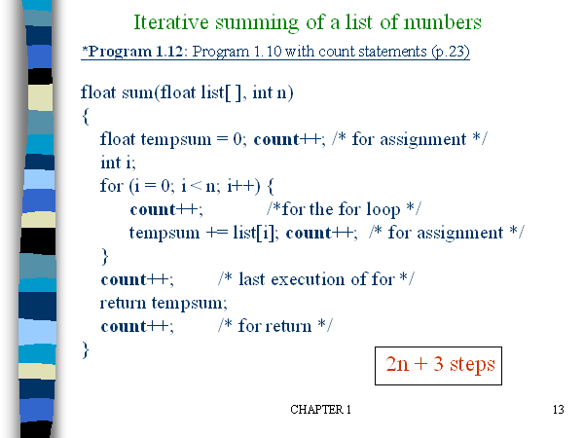

Slide 21
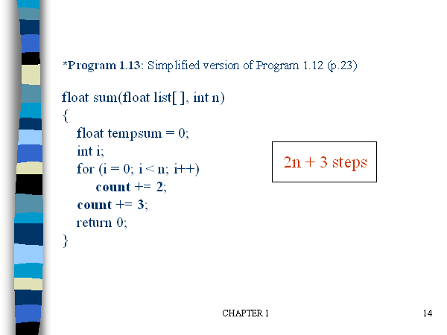

Slide 22
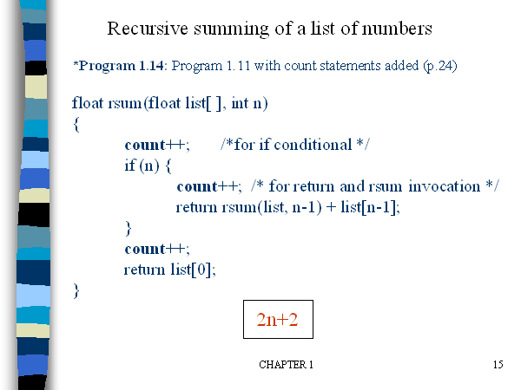

Slide 23
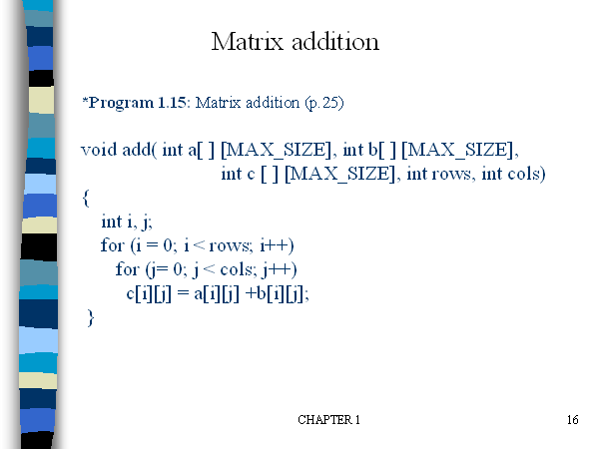

Slide 24
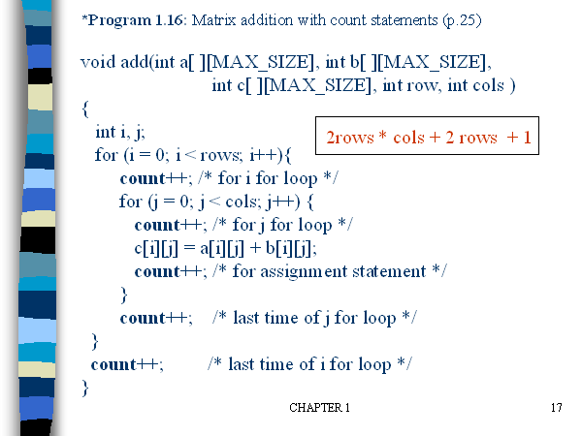

Slide 25
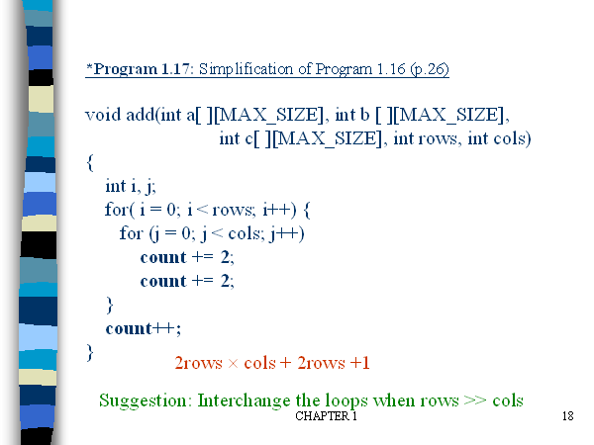

Slide 27
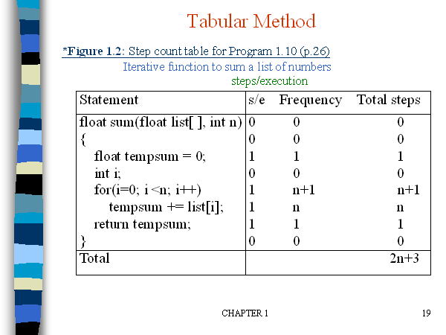

Slide 28
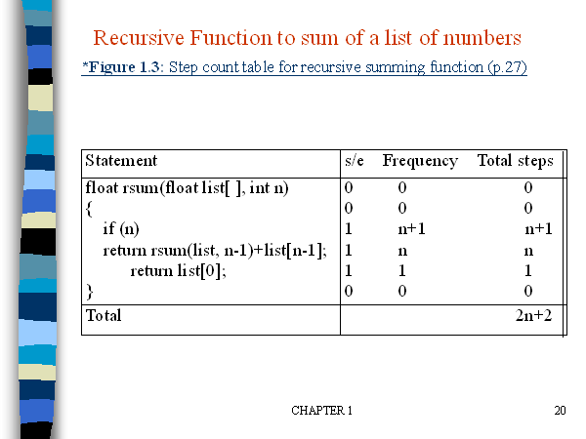

Slide 29
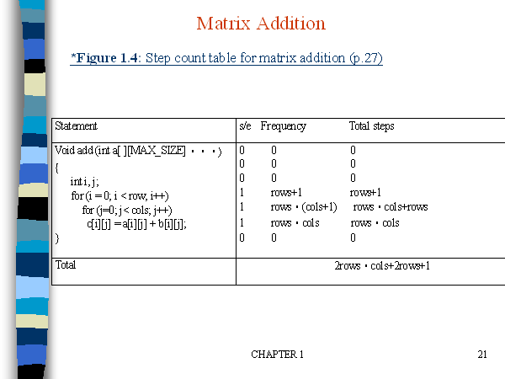

Slide 30
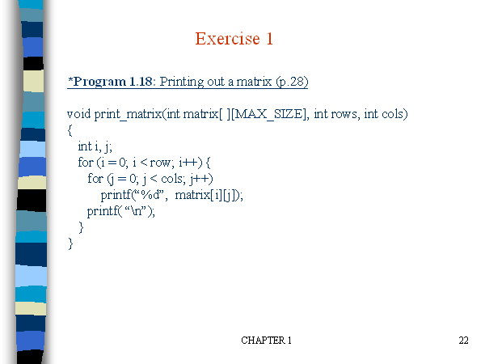

Slide 31
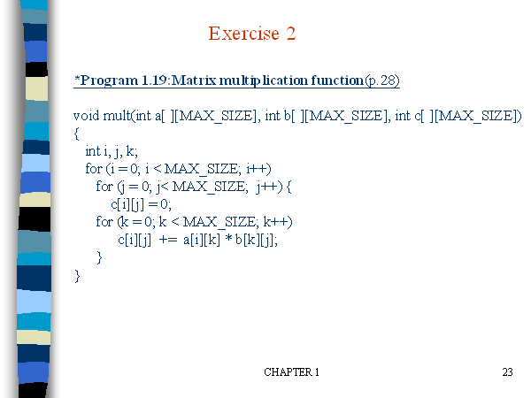

Slide 32
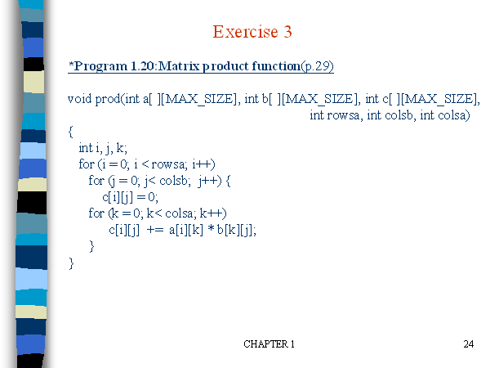

Slide 33
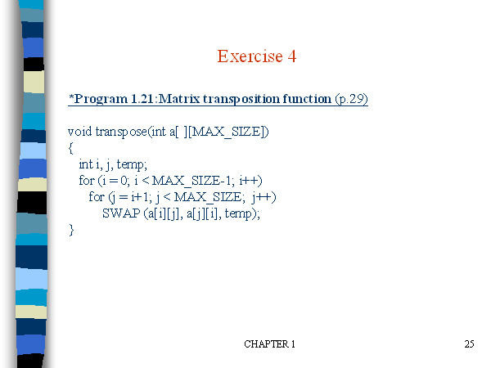

Slide 34
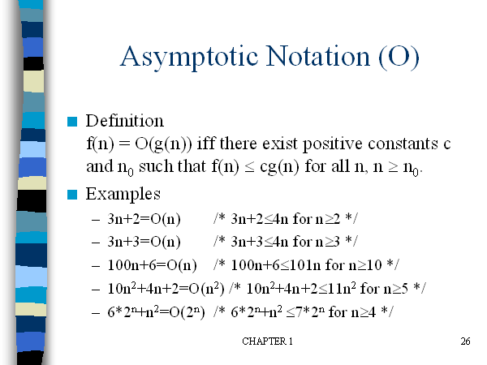

Slide 35
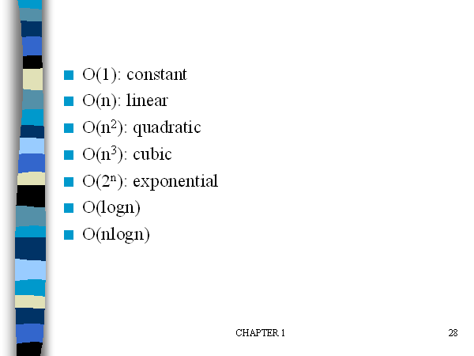

Slide 36
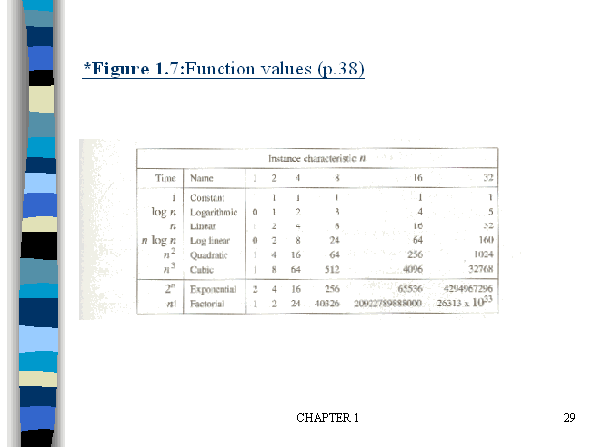

Slide 37
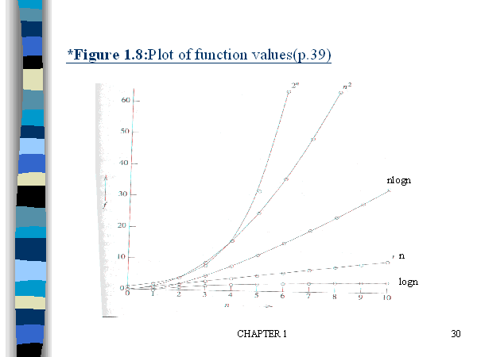

Slide 38
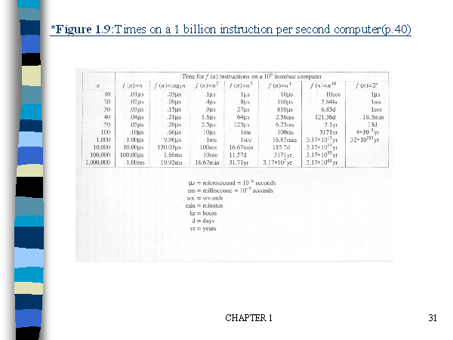

Slide 39
Divide and Conquer Method

Slide 40
1. Divide-Conquer Methods
2. Binary search
3. Merge sort
4. Quick sort

Slide 41
Divide-and-conquer approach
Divide-and-Conquer divides an instance of a problem into two or more smaller instances.
The smaller instances are usually instances of the original problem.
If solutions to the smaller instances can be obtained readily, the solution to the original instance can be obtained by combining these solutions.

Slide 42
If the smaller instances are still too large to be solved readily, they can be divided into still smaller instances.
This process of dividing the instances continues until they are so small that a solution is readily obtainable.

Slide 43
The divide-and-conquer approach is a top down Approach.
That is, the solution to a top-level instance of a problem is obtained by going down and obtaining solutions to smaller instances.
this is the method used by recursive routines.

Slide 44
Divide-and-conquer approach (Cont.)
The divide-and-conquer paradigm involves three steps at each level of the recursion: Divide the problem into a number of subproblems. Conquer the subproblems by solving them recursively. If the subproblem sizes are small enough, however, just solve the subproblems in a straightforward manner. Combine the solutions to the subproblems into the sloution for the original problem.

Slide 45
General Method-control abstraction
Algorithm DAndC(P)
{
If Small(P) then return S(P);
Else
{
Divide P into smaller instances P₁,P₂,….P_{K}. k>=1;
Apply DAndC to each of these subproblems;
Return Combine(DAndC(P₁),DAndC(P₂),…DAndC(P_{K});
}
}

Slide 46
T(n)= { g(n) n small
T(n₁)+T(n₂)+…+T(n_{k})+f(n) otherwise
Generally complexity for recurrences is given by
T(n)={ T(1) n=1
aT(n/b)+f(n) n>1
a,b are constants, n=b^{k}

Slide 47
Consider the case in which a=2 and b=2. Let T(1)=2 & f(n)=n.
We have,
T(n) = 2T(n/2)+n
= 2[2T(n/2/2)+n/2]+n
= [4T(n/4)+n]+n
= 4T(n/4)+2n
= 4[2T(n/4/2)+n/4]+2n
= 4[2T(n/8)+n/4]+2n
= 8T(n/8)+n+2n
= 8T(n/8)+3n

Slide 48
In general, we see that T(n)=2^iT(n/2^i )+in., for any log n >=I>=1.
→ T(n) =2^log n T(n/2^log n) + n log n
→Corresponding to the choice of i=log n
Thus, T(n) = 2^log n T(n/2^log n) + n log n
= n.T(n/n) + n log n
= n. T(1) + n log n
= 2n + n log n

Slide 49
Binary Search
The divide-and-conquer steps of Binary Search:
If x equals the middle item, quit.
Otherwise:
(1)Divide–the array into two subarrays about half as large. If x is smaller than the middle item, choose the left subarray. If x is larger than the middle item, choose the right subarray.
(2)Conquer-(solve) the subarray by determining whether x is in that subarray. Unless the subarray is sufficiently small, use recursion to do this.

Slide 50
(3)Combine-–the solution to the array from the solution to the subarray. No need for combining.

Slide 51
Recursive binary search algorithm
1. //ALGORITHM:Binsearch(a,i,l,x). 2. //given an array a(i,l) of elements in non-decreasing. 3.// order,1<=i<=l, determine whether x is present and 4. //if so, return j such that x=a[j], else return 0. 5. { 6. if(l=i) then { if(x=a[i] then return i; else return 0; }

Slide 52
else { // reduce P into smaller subproblems mid=[(i+l)/2] if(x=a[mid] then return mid else if(x<a[mid]) then return Binsearch(a,i,mid-1,x) else return Binsearch(a.mid+1,l,x) } }

Slide 53
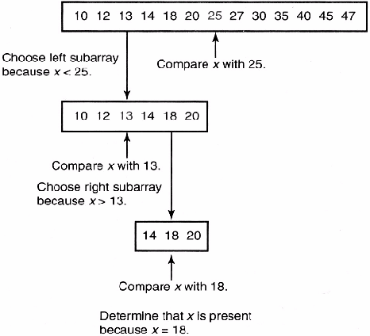
x=18

Slide 54
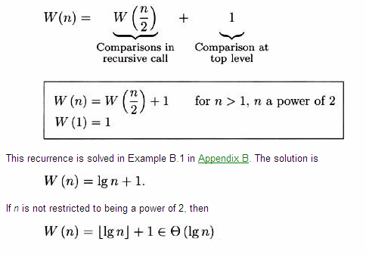
Analysis of Algorithm Worst-Case Time Complexity (Binary Search, Recursive)

Slide 55
Successful search
Best : O(1)
Average : O(log n)
Worst: O(log n)
Unsuccessful search : O(log n)

Slide 56
Example: Find the MAX and MIN
Obvious strategy (Needs 2n - 3 compares)
Find MAX (n - 1 compares)
Find MIN of the remaining elements (n - 2)
Nontrivial strategy
Split the array in half
Find the MAX and MIN of both halves
Compare the 2 MAXes and compare the 2 MINs to get overall MAX and MIN.
In this example, we only consider the number of comparisons and ignore all other operations.

Slide 57
Procedure mm(i, j: integer; var lo, hi: integer);
begin
if i = j
then begin lo := a[i]; hi := a[i] end
else if i = j-1
then begin if a[i] < a[j]
then begin lo := a [i]; hi := a[j] end
else begin lo := a [j]; hi := a[i] end
end
else begin
m := (i+j) div 2;
mm(i, m, min1, max1);
mm(m+1, j, min2, max2);
lo := MIN(min1, min2);
hi := MAX(max1, max2)
end
end.

Slide 58
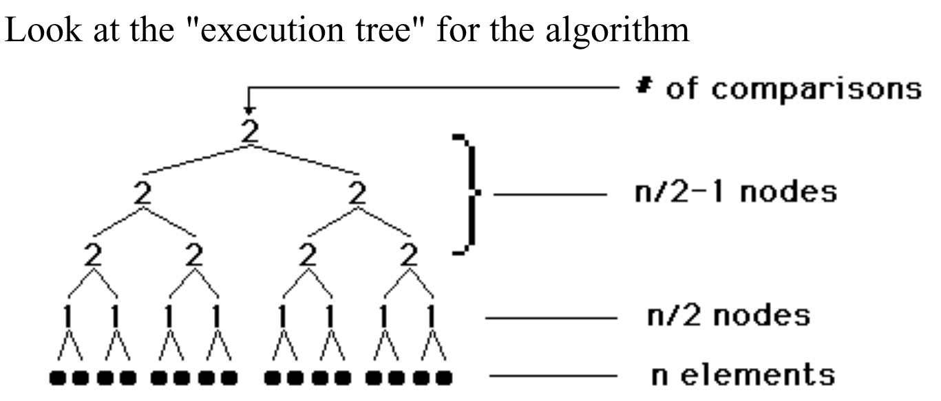
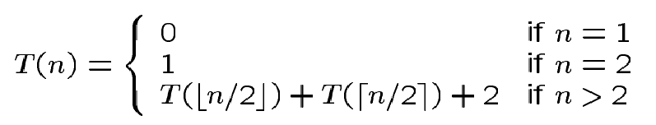
Analysis

Slide 59
Note
More accurately, it should be
Solving the above, we have T(n) = 3n/2 –2 if n is a power of 2.
This can be shown to be a lower bound.

Slide 60
Merge sort
The merge sort algorithm closely follows the divide-and-conquer paradigm. Intuitively, it operates as follows. Divide: Divide the n-element sequence to be sorted into two subsequences of n/2 elements each. Conquer: Sort the two subsequences recursively using merge sort. Combine: Merge the two sorted subsequences to produce the sorted answer.

Slide 61
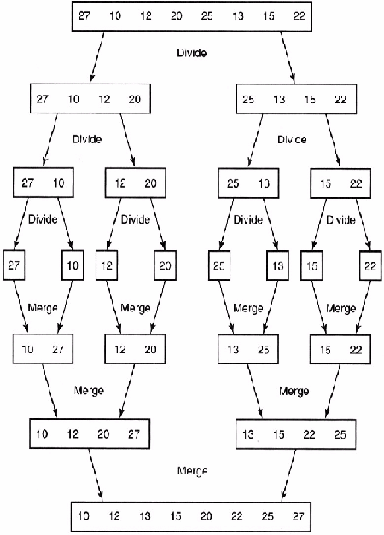

Slide 62
Merge sort using recursion
Input: An array A and indices low and high Output: An sorted array A MERGE-SORT(A, low, high) 1. if low< high 2. then mid = (low + high) / 2 3. MERGE-SORT(A, low, mid)
4. MERGE-SORT(A, mid+1, high) 5. MERGE(A, low, mid, high)

Slide 63
Algorithm: Merging 2 sorted subarrays using auxiliary storage.
Algorithm merge(low,mid,high)
//a[low:high] is a global array containing
//two sorted subsets in a[low:mid]
//and in a[mid+1:high].The goal is to merge these 2 sets into
//a single set residing in a[low:high].b[] is an auxiliary global array.

Slide 64
{
h=low; I=low; j=mid+1;
while ((h<=mid) and (j<=high)) do
{
if (a[h]<=a[j]) then
{
b[I]=a[h];
h = h+1;
}

Slide 65
else
{
b[I]= a[j];
j=j+1;
}
I=I+1;
}

Slide 66
if (h=mid) then
for k=j to high do
{
b[I]=a[k]; I=I+1;
}
else
for k=h to mid do
{ b[I]=a[k]; I=I+1; }
for k=low to high do a[k] = b[k];
}

Slide 67
Time Complexity –Merge Sort
T(n) =a n=1 a is constant
= 2T(n/2) + cn. n>1 c is constant In the same way: T(n/2) = 2T(n/4) + cn/2, so T(n) = 4T(n/4) + 2cn. Going in this way ...
T(n) = 2^{k}T(n/2^{k}) + kcn
= nT(1) + cnlog₂n = O(n log n).
Remember, as n=2^{k} k = log₂n!
The general case requires a bit more work, but it takes O(n log n) time anyway.

Slide 68
Introduction
Quicksort
Fastest known sorting algorithm in practice
Average case: O(N log N)
Worst case: O(N²)
But, the worst case seldom happens.

Slide 69
Quicksort
S
Divide step:
Pick any element (pivot) v in S
Partition S – {v} into two disjoint groups
S1 = {x ∈ S – {v} | x <= v}
S2 = {x ∈ S – {v} | x ≥ v}
Note: S1 and S2 may overlap. Why?
Conquer step: recursively sort S1 and S2
Combine step: the sorted S1 (by the time returned from recursion), followed by v, followed by the sorted S2 (i.e., nothing extra needs to be done)
v
v
S1
S2

Slide 70
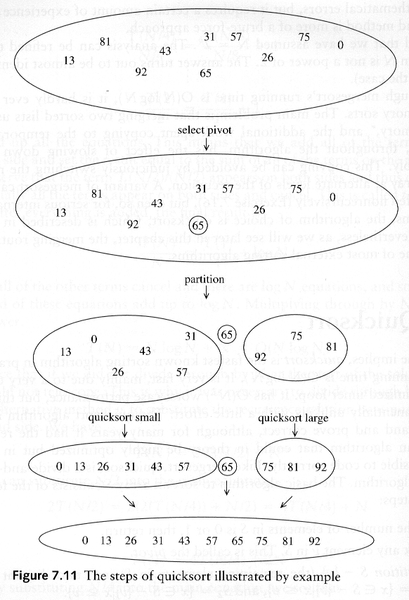
Example: Quicksort

Slide 71
Example: Quicksort...

Slide 72
Pseudocode
Input: an array A[p, r]
Quicksort (A, p, r) {
if (p < r) {
q = Partition (A, p, r) //q is the position of the pivot element
Quicksort (A, p, q-1)
Quicksort (A, q+1, r)
}
}

Slide 73
Partitioning
Partitioning
This is a key step of the quicksort algorithm
Goal: given the picked pivot, partition the remaining elements into two smaller sets
Many ways to implement how to partition:
Even the slightest deviations may cause surprisingly bad results.
We will learn an easy and efficient partitioning strategy here.
How to pick a pivot will be discussed later

Slide 74
Partitioning Strategy
Want to partition an array A[left .. right]
First, get the pivot element out of the way by swapping it with the last element. (Swap pivot and A[right])
Let i start at the first element and j start at the next-to-last element (i = left, j = right – 1)
swap
5
6
4
6
3
12
19
5
6
4
19
3
12
6
pivot
i
j

Slide 75
Partitioning Strategy
Want to have
A[p] <= pivot, for p < i
A[p] >= pivot, for p > j
When i < j
Move i right, skipping over elements smaller than the pivot
Move j left, skipping over elements greater than the pivot
When both i and j have stopped
A[i] >= pivot
A[j] <= pivot { A[i] and A[j] should now be swapped}
<= pivot
>= pivot
i
j
5
6
4
19
3
12
6
5
6
4
19
3
12
6
i
j
i
j

Slide 76
Partitioning Strategy
When i and j have stopped and i is to the left of j (thus legal)
Swap A[i] and A[j]
The large element is pushed to the right and the small element is pushed to the left
After swapping
A[i] <= pivot
A[j] >= pivot
Repeat the process until i and j cross
swap
5
6
4
19
3
12
6
5
3
4
19
6
12
6
i
j
i
j

Slide 77
Partitioning Strategy
5
3
4
19
6
12
6
When i and j have crossed
Swap A[i] and pivot
Result:
A[p] <= pivot, for p < i
A[p] >= pivot, for p > i
i
j
5
3
4
19
6
12
6
Swap!
i
j
5
3
4
6
6
12
19
break!
j
i

Slide 78
Conventional Matrix Multiplication
Brute-force algorithm
c₀₀ c₀₁ a₀₀ a₀₁ b₀₀ b₀₁
= *
c₁₀ c₁₁ a₁₀ a₁₁ b₁₀ b₁₁
a₀₀ * b₀₀ + a₀₁ * b₁₀ a₀₀ * b₀₁ + a₀₁ * b₁₁
=
a₁₀ * b₀₀ + a₁₁ * b₁₀ a₁₀ * b₀₁ + a₁₁ * b₁₁
8 multiplications
Efficiency class in general: Θ (n³)
4 additions

Slide 79
Strassen’s Matrix Multiplication
Strassen’s algorithm for two 2x2 matrices (1969):
c₀₀ c₀₁ a₀₀ a₀₁ b₀₀ b₀₁
= *
c₁₀ c₁₁ a₁₀ a₁₁ b₁₀ b₁₁
m₁ + m₄ - m₅ + m₇ m₃ + m₅
=
m₂ + m₄ m₁ + m₃ - m₂ + m₆
m₁ = (a₀₀ + a₁₁) * (b₀₀ + b₁₁)
m₂ = (a₁₀ + a₁₁) * b₀₀
m₃ = a₀₀ * (b₀₁ - b₁₁)
m₄ = a₁₁ * (b₁₀ - b₀₀)
m₅ = (a₀₀ + a₀₁) * b₁₁
m₆ = (a₁₀ - a₀₀) * (b₀₀ + b₀₁)
m₇ = (a₀₁ - a₁₁) * (b₁₀ + b₁₁)
7 multiplications
18 additions

Slide 80
Strassen’s Matrix Multiplication
Strassen observed [1969] that the product of two matrices can be computed in general as follows:
C₀₀ C₀₁ A₀₀ A₀₁ B₀₀ B₀₁
= *
C₁₀ C₁₁ A₁₀ A₁₁ B₁₀ B₁₁
M₁ + M₄ - M₅ + M₇ M₃ + M₅
=
M₂ + M₄ M₁ + M₃ - M₂ + M₆

Slide 81
Formulas for Strassen’s Algorithm
M₁ = (A₀₀ + A₁₁) ∗ (B₀₀ + B₁₁)
M₂ = (A₁₀ + A₁₁) ∗ B₀₀
M₃ = A₀₀ ∗ (B₀₁ - B₁₁)
M₄ = A₁₁ ∗ (B₁₀ - B₀₀)
M₅ = (A₀₀ + A₀₁) ∗ B₁₁
M₆ = (A₁₀ - A₀₀) ∗ (B₀₀ + B₀₁)
M₇ = (A₀₁ - A₁₁) ∗ (B₁₀ + B₁₁)

Slide 82
Analysis of Strassen’s Algorithm
If n is not a power of 2, matrices can be padded with zeros.
Number of multiplications:
M(n) = 7M(n/2), M(1) = 1
Solution: M(n) = 7^{log 2n} = n^{log 27} ≈ n^{2.807} vs. n³ of brute-force alg.
Algorithms with better asymptotic efficiency are known but they are even more complex and not used in practice.
What if we count both multiplications and additions?

Slide 83
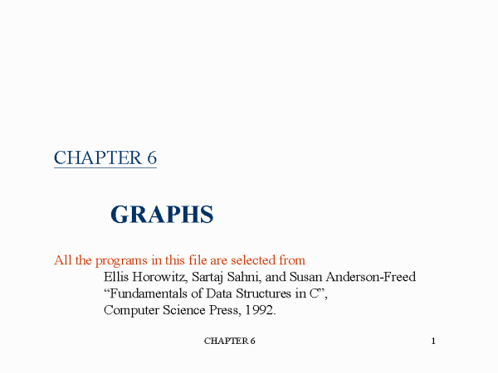

Slide 84
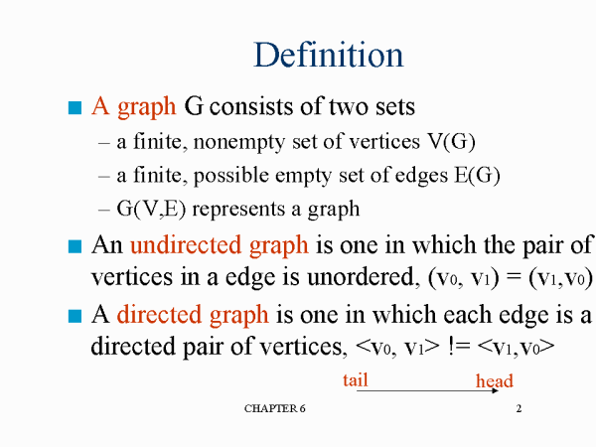

Slide 85
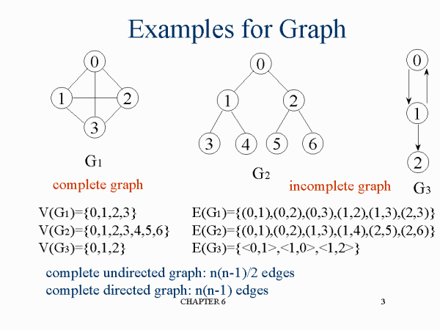

Slide 86
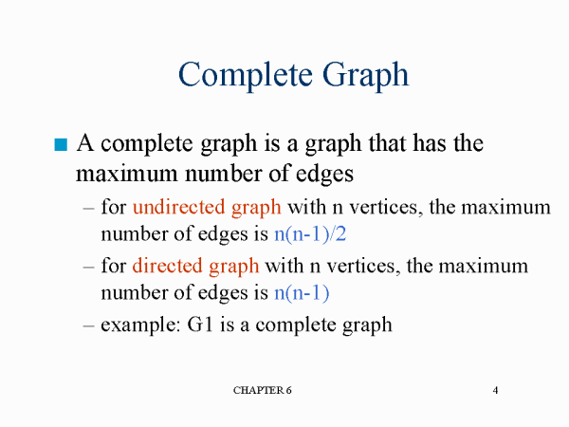

Slide 87
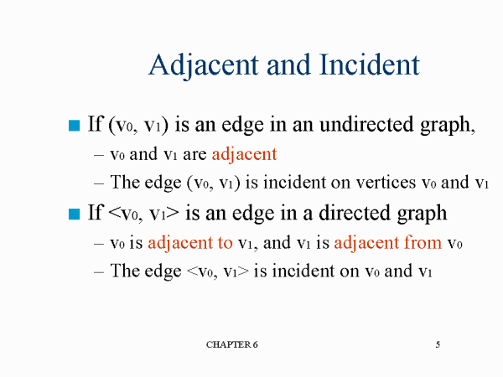

Slide 88
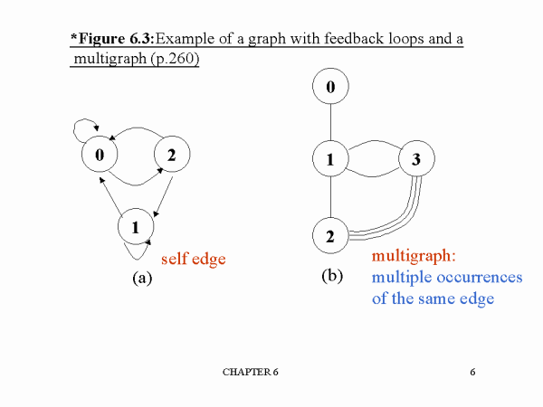

Slide 89
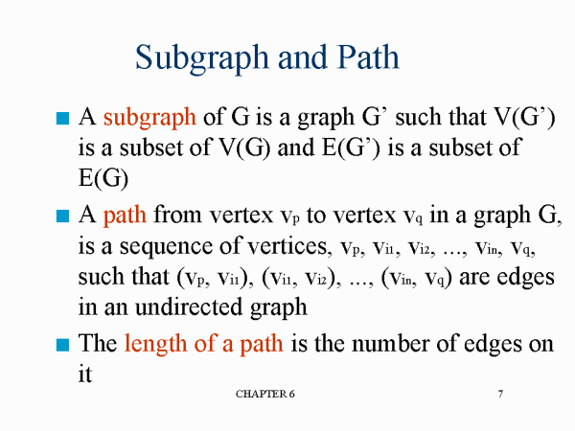

Slide 90
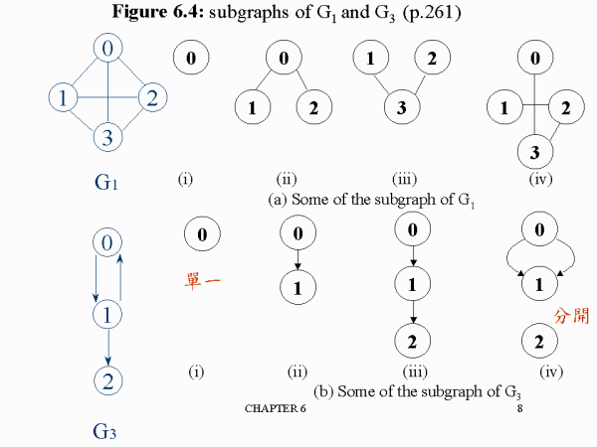

Slide 91
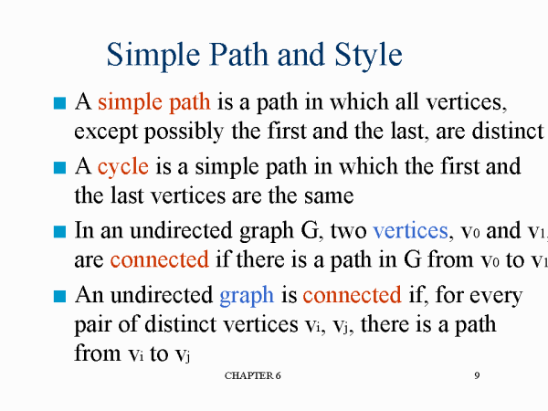

Slide 92
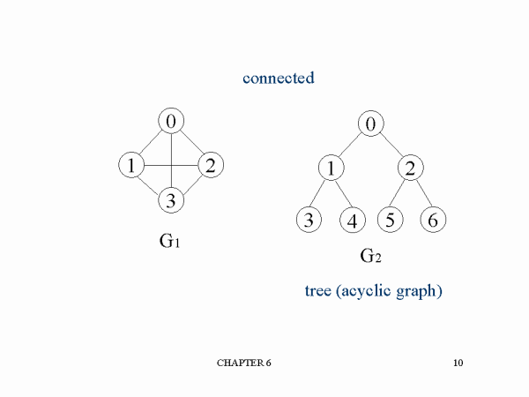

Slide 93
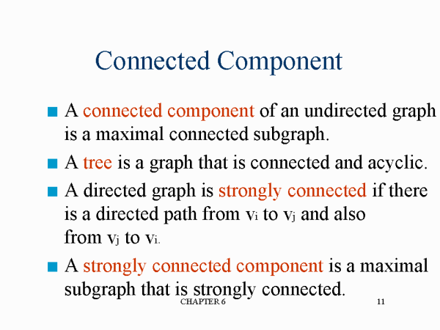

Slide 94
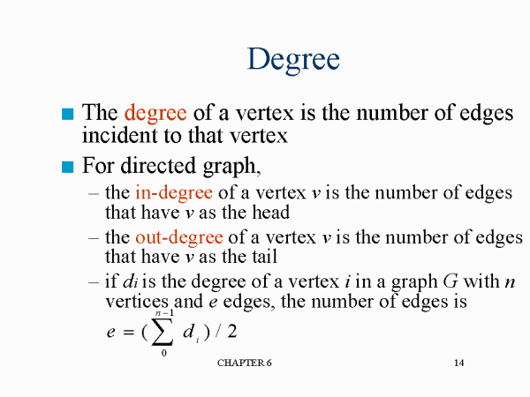

Slide 95
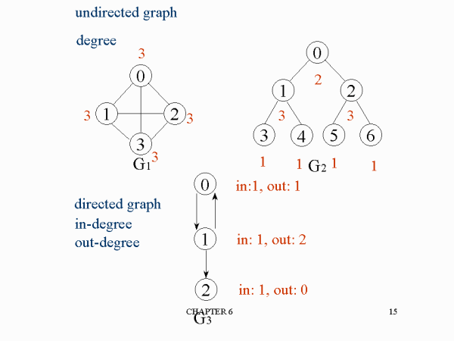

Slide 96
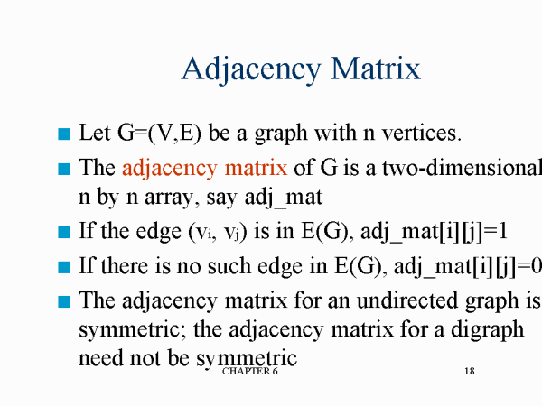

Slide 97
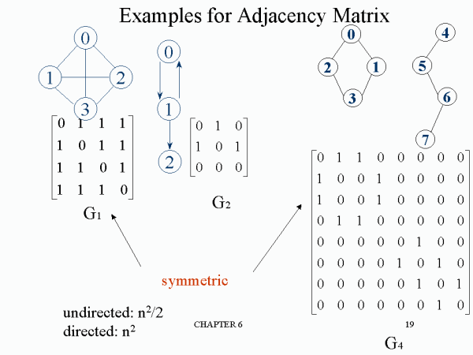

Slide 98
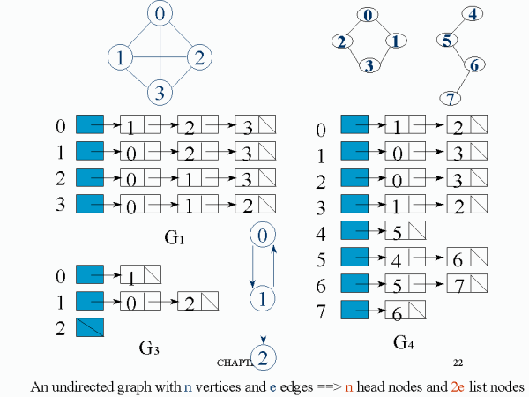

Slide 99


Slide 100
Greedy method

Slide 101
General Method
Feasible solution-constraints
Objective function- maximise or minimise
Optimal solution
Subset paradigm
Ordering paradigm

Slide 102
Control abstraction for greedy method- Subset paradigm
1. Algorithm Greedy (a,n)
2. //a[1:n] contain the ‘n’ inputs
3. {
4. solution =0;//Initialise the solution.
5. For i=1 to n do
6. {
7. x=select(a);
8. if(feasible(solution,x))then
9. solution=union(solution,x);
10. }
11. return solution;
12. }

Slide 103
Knapsack Problem
We are given n objects and knapsack or bag with capacity M
Object i has a weight W_{i} where i varies from 1 to n.
The problem is to fill the bag with the help of objects and the resulting profit has to be maximum.
Fraction x_{i}, 0<=x_{i}<=1 of object i is placed into the knapsack then profit p_{i}x_{i} is earned

Slide 104
Maximise ∑ p_{i}x_{i} 1≤ i ≤ n
Subject to ∑ w_{i}x_{i} ≤ m 1≤ i ≤ n
0≤ x_{i}≤ 1 1≤ i ≤ n

Slide 105
Example
Capacity=20
N=3, M=20
Wi=18, 15, 10
Pi=25, 24, 15

Slide 106
X₁ X₂ X₃ W_{i}X_{i} P_{i}X_{i}
½ 1/3 ¼
1 2/15 0
0 2/3 1
0 1 ½

Slide 107
X₁ X₂ X₃ W_{i}X_{i} P_{i}X_{i}
½ 1/3 ¼ (1/2)*18+(1/3) *15+(1/4)*10 =16.5 (1/2)*25+(1/3) *24+(1/4)*15 = 24.25
1 2/15 0 (1)*18+(2/15) *15+(0)*10 = 20 (1)*25+(2/15) *24+(0)*15 = 28.2
0 2/3 1 (0)*18+(2/3) *15+(1)*10 = 20 (0)*25+(2/3) *24+(1)*15 = 31
0 1 ½ (0)*18+(1) *15+(1/2)*10 = 20 (0)*25+(1) *24+(1/2)*15 = 31.5

Slide 108
Order by profit
Weight profit wt reqd/wt
X₁ 18 25
X₂ 15 24
X₃ 10 15

Slide 109
Weight profit wt reqd/wt
X₁ 18 25 1.0
X₂ 15 24 (2/15)0.133
X₃ 10 15 0
∑P_{i}X_{i} = 1*25+0.133*24
= 28.192

Slide 110
Weight profit pi/wi wt reqd/wt
X ₂ 15 24 1.6 1
X ₃ 10 15 1.5 (5/10) 0.5
X₁ 18 25 1.38 0
∑ P_{i}X_{i} = 1*24+0.5*15
=31.5 (optimal solution)

Slide 111
Order by weight(capacity)
Weight profit wt reqd/wt
X ₃ 10 15
X₂ 15 24
X₁ 18 25

Slide 112
Weight profit wt reqd/wt
X₃ 10 15 1.0
X₂ 15 24 (10/15)0.67
X₁ 18 25 0
∑ P_{i}X_{i} = 1*15+0.67*24
=31

Slide 113
Order by ratio of accumulated profit to capacity(P_{i} /W_{i} )
Weight profit pi/wi
X ₂ 15 24 1.6
X ₃ 10 15 1.5
X₁ 18 25 1.38

Slide 114
Algorithm
1.Algorityhm Greedy knapsack (m,n)
2//P[1:n] and the w[1:n]contain the profit
3.// & weight res’.of the n object ordered.
4.//such that p[i]/w[i] >=p[i+1]/W[i+1]
5.//m is the Knapsack size and x[1:n] is the solution vertex.
6.{
7.for i=1 to n do x[i]=0.0;
8.U=m;
9.For i=1 to n do
10.{
11.if (w[i]>U)then break;
13.x[i]=1.0;U=U-w[i]
14.}
15.if(i<=n)then x[i]=U/w[i];
16.}

Slide 115


Slide 117


Slide 118


Slide 119


Slide 120


Slide 121


Slide 122


Slide 123


Slide 124


Slide 125


Slide 126


Slide 127


Slide 128


Slide 129


Slide 130


Slide 131


Slide 132


Slide 133


Slide 134


Slide 135


Slide 136
Optimal Storage on Tapes
Optimal Storage on Tapes is one of the application of the Greedy Method.
The objective is to find the optimal retrieval time for accessing programs that are stored on tape.

Slide 137
Description
There are n programs that are to be stored on a computer tape of length L.
Associated with each program i is a length l;
Clearly, all programs can be stored on the tape if and only if the sum of the lengths of the programs is at most L.
We shall assume that whenever a program is to be retrieved from this tape, the tape is initially positioned at the front.

Slide 138

Description
Hence' if the programs are stored in the order I=i₁, i_{2’} i_{3 ….} i_{n} the time t_{j} needed to retrieve program i_{j} is proportional to l_{ik} .
If all programs are retrieved equally often then the expected or mean retrieval time (MRT) is

Slide 139

Example

Slide 140
Method
The greedy method simply requires us to store the programs in non-decreasing order of their lengths.
This ordering (sorting) can be carried out in O(n log n) time using an efficient sorting algorithm

Slide 141

Algorithm for multiple tapes
Note: The programs are assumed to be in increasing order of their lengths

Slide 142
The 2-way merging problem
# of comparisons required for the linear 2-way merge algorithm is m₁+ m₂ -1 where m₁ and m₂ are the lengths of the two sorted lists respectively.
2-way merging example
2 3 5 6
1 4 7 8
The problem: There are n sorted lists, each of length m_{i}. What is the optimal sequence of merging process to merge these n lists into one sorted list ?

Slide 143

Extended binary trees
An extended binary tree representing a 2-way merge

Slide 144


An example of 2-way merging
Example: 6 sorted lists with lengths 2, 3, 5, 7, 11 and 13.

Slide 145



Time complexity for generating an optimal extended binary tree:O(n log n)

Slide 146
Huffman codes
In telecommunication, how do we represent a set of messages, each with an access frequency, by a sequence of 0’s and 1’s?
To minimize the transmission and decoding costs, we may use short strings to represent more frequently used messages.
This problem can by solved by using an extended binary tree which is used in the 2-way merging problem.

Slide 147

An example of Huffman algorithm
Symbols: A, B, C, D, E, F, G
freq. : 2, 3, 5, 8, 13, 15, 18
Huffman codes:
A: 10100 B: 10101 C: 1011
D: 100 E: 00 F: 01
G: 11
A Huffman code Tree

Slide 148
4.8 SINGLE-SOURCE SHORTEST PATHS
Graphs can be used to represent the highway structure of a state or country with vertices representing cities and edges representing sections of highway.
The edges can then be assigned weights which may be either the distance between the two cities connected by the edge or the average time to drive along that section of highway.

Slide 149

4.8 SINGLE-SOURCE SHORTEST PATHS
A motorist wishing to drive from city A to B would be interested in answers to the following questions:
Is there a path from A to B
If there is more than one path from A to B, which is the shortest path?

Slide 150
4.8 SINGLE-SOURCE SHORTEST PATHS
The problem is defined by these questions are special cases of the path problem.
The length of a path is now defined to be the sum of the weights of the edges on that path.
The starting vertex of the path is referred to as the source, and the last vertex the destination.
The graphs are digraphs to allow for one-way streets.

Slide 151
4.8 SINGLE-SOURCE SHORTEST PATHS
In the problem we consider, we are given a directed graph G = (V,E), a weighting function cost for the edges of G, and a source vertex v₀.
The problem is to determine the shortest paths from v₀ to all the remaining vertices of G.
It is assumed that all the weights are positive.
The shortest path between v₀ and some other node v is an ordering among a subset of the edges. Hence this problem fits the ordering paradigm.

Slide 152
4.8 SINGLE-SOURCE SHORTEST PATHS
Example 4.11
Consider the directed graph of Figure 4.15(a).
The numbers on the edges are the weights.
If node 1 is the source vertex, then the shortest path from 1 to 2 is 1, 4, 5, 2.
The length of this path is 10+ 15+ 20 = 45.
Even though there are three edges on this path, it is shorter than the path 1,2 which is of length 50. There is no path from 1 to 6.

Slide 153

Figure 6,29 (b) lists the shortest paths from node1 to nodes 4, 5, 2, and 3, respectively. The paths have been listed in nondecreasing order of path length.

Slide 154
4.8 SINGLE-SOURCE SHORTEST PATHS
To formulate a greedy-based algorithm to generate the shortest paths, we must conceive of a multistage solution to the problem and also of an Optimization measure.
One possibility is to build the shortest paths one by one.
As an optimization measure we can use the sum of the lengths of all paths so far generated.
For this measure to be minimized each individual path must be of minimum length.

Slide 155
4.8 SINGLE-SOURCE SHORTEST PATHS
If we have already constructed i shortest paths, then using this optimization measure, the next path to be constructed should be the next shortest minimum length path.
The greedy way (and also a systematic way) to generate the shortest paths from v₀ to the remaining vertices is to generate these paths in nondecreasing order of path length.

Slide 156
4.8 SINGLE-SOURCE SHORTEST PATHS
First, a shortest path to the first nearest vertex is generated.
Then a shortest path to the second nearest vertex is generated, and so on.
For the graph of Figure 6.29(a) the nearest vertex to v₀ = v₂ is 2 cost[0,2] =10).
The path 0,2 is the first path generated.
The second nearest vertex to node v₀ is v₃and the distance between v₀ and v₃ is 25.

Slide 157
4.8 SINGLE-SOURCE SHORTEST PATHS
The path 1,4,5 is the next path generated.
In order to generate the shortest paths in this order, we need to be able to determine
(1) the next vertex to which a shortest path must be generated and (
2) a shortest path to this vertex.

Slide 158
4.8 SINGLE-SOURCE SHORTEST PATHS
Let S denote the set of vertices (including v₀) to which the shortest paths have already been generated.
For w not in S, let dist[w] be the length of the shortest path starting from vo, going through only those vertices that are in S, and ending at w.

Slide 159
4.8 SINGLE-SOURCE SHORTEST PATHS
We observe that:
1.If the next shortest path is to vertex u, then the path begins at v₀, ends at u, and goes through only those vertices that are in S.
To prove this, we must show that all the intermediate vertices on the shortest path to u are in S.
Assume there is a vertex w on this path that is not in S.

Slide 160
4.8 SINGLE-SOURCE SHORTEST PATHS
Then, the v₀ to u path also contains a path from v₀ to w that is of length less than the v₀ to u path.
By assumption the shortest paths are being generated in nondecreasing order of path length, and so the shorter path v₀ to w must already have been generated.
Hence, there can be no intermediate vertex that is not in S.

Slide 161
4.8 SINGLE-SOURCE SHORTEST PATHS
2.The destination of the next path generated must be that of vertex u which has the minimum distance, dist[u], among all vertices not in S.
This follows from the definition of dist and observation. In case there are several vertices not in S with the same dist, then any of these may be selected.

Slide 162
4.8 SINGLE-SOURCE SHORTEST PATHS
3. Having selected a vertex u as in observation and generated the shortest vo to u path, vertex u becomes a member of S.
At this point the length of the shortest paths starting at v₀, going though vertices only in S, and ending at a vertex w not in S may decrease; that is, the value of dist[w] may change.
If it does change, then it must be due to a shorter path starting at v₀ and going to u and then to w.

Slide 163
4.8 SINGLE-SOURCE SHORTEST PATHS
The intermediate vertices on the vq to u path and the u to w path must all be in S.
Further, the v₀ to u path must be the shortest such path; otherwise dist[w] is not defined properly.
Also, the u to w path can be chosen so as not to contain any intermediate vertices.
Therefore, we can conclude that if dist[w] is to change(i.e. decrease), then it is because of a path from v₀ to u to w, where the path from vo to u is the shortest such path and the path from u to w is the edge(u,w).

Slide 164
4.8 SINGLE-SOURCE SHORTEST PATHS
The lengthof this path is dist[u]+cost[u,w].
The above observations lead to a simple Algorithm 4.14 for the single source shortest path problem.
This algorithm(known as Dijkstra's algorithm) only determines the lengths of the shortest paths from v₀ to all other vertices in G.
In the function ShortestPaths (Algorithm 4.14) it is assumed that the n vertices of G are numbered 1 through n.

Slide 165
4.8 SINGLE-SOURCE SHORTEST PATHS
The set S is maintained as a bit array with S[i]= 0 if vertex i is not in S and S[i] = 1 if it is.
It is assumed that the graph itself is represented by its cost Adjacency matrix with cos[i, j]'s being the weight of the edge(i,j).
The weight cost[i,j] is set to some large number, ∞, in case the edge{i,j) is not in E(G).
For i = j, cost[j,i] can be set to any nonnegative number without affecting the outcome of the algorithm.

Slide 167


Slide 168


Slide 169



Slide 170


Slide 171


Slide 172



Slide 174


Slide 175


Slide 176


Slide 177

Gaussian elimination
2 cycles C₁ and C₂ are represented by a 0/1 matrix
E.g.
⊕ on rows 1 and 3
Add C₃
on rows 2 and 3 : empty
∵C₃ = C₁ ⊕ C₂

Slide 178
Minimum cost Spanning trees
Let G (V, E) be an undirected connected graph with vertices ‘v’ and edge ‘E’.
A sub-graph t= (V, E’) of G is a Spanning tree of G iff ‘t’ is a tree.
A spanning tree of a graph is an undirected tree consisting of only those edges that are necessary to connect all the vertices in the original graph.
A Spanning tree has a property that for any pair of vertices there exist only one path between them and the insertion of an edge to a spanning tree form a unique cycle

Slide 179
The cost of spanning tree is the sum of cost of edges in those trees. There are 2 methods to determine a minimum cost spanning tree. They are
1. Kruskal’s Algorithm
2. Prim’s Algorithm

Slide 180
Prim’s algorithm
A greedy method to obtain a minimum cost spanning tree builds this tree edge by edge.
Next edge chosen according to some optimisation criteria.(edge that results in minimum increase in sum of costs of the edges so far included)

Slide 181
All vertices are marked as not visited
2. Any vertex v you like is chosen as starting vertex and
is marked as visited (define a cluster C)
The smallest- weighted edge e = (v,u), which connects
one vertex v inside the cluster C with another vertex u outside of C, is chosen and is added to the MST.
4. The process is repeated until a spanning tree is formed

Slide 182
Algorithm
Algorithm Prim(E,cost,n,t)
// E is the set of edges in G
//Cost[1:n,1:n]- cost adj matrix of n vertex
//Stored as t[1:n-1,1:2],final cost is returned
let (k,l) be an edge of min cost inE;
Mincost:=cost[k,l];
T[1,1]:=k; t[1,2]:=l;
For i:=1 to n do //initialise near
if cost[i,l]<cost[i,k]) then near[i]:=l;
else near[i]:=k;
near[k]:=near[l]:=0
for i:=2 to n-1 do
{//find n-2 additional edges for t
let j be an index such that near[j]!=0 and cost[j,near[j]] is minimum;
t[i,1]:=j; t[i,2]:=near[j];

Slide 183
Mincost=mincost+cost[j,near[j]];
Near[j]:=0;
for k:=1 to n do //updata near[]
if (near[k]!=0) and (cost[k,near[k]])> cost[k,j] then
near[k]:=j;
}
Return mincost;
}

Slide 184


Slide 185


Slide 186
Time complexity
A simple implementation using an adjacency matrix graph representation and searching an array of weights to find the minimum weight edge to add requires O(V^2) running time.
Using a simple binary heap data structure and an adjacency list representation, Prim's algorithm can be shown to run in time which is O(Elog V) where E is the number of edges and V is the number of vertices.

Slide 187
Kruskal algorithm
In this algorithm, a minimum cost-spanning tree ‘T’ is built edge by edge.
Edge are considered for inclusion in ‘T’ in increasing order of their cost.
An edge is included in ‘T’ if it doesn’t form a cycle with edge already in T.
To find the minimum cost spanning tree the edge are inserted to tree in increasing order of their cost .

Slide 188
Algorithm kruskal(E,cost,n,t)
//E→set of edges in G has ‘n’ vertices.
//cost[u,v]→cost of edge (u,v).
//t→set of edges in the minimum-cost spanning tree. The final cost is returned.

Slide 189
{
Construct a heap out of edge costs using Heapify;
for i:=1 to n do parent[i]:=-1;
i:=0; mincost:=0.0;
While ((i<n-1) and (heap not empty)) do
{
Delete a minimum cost edge (u, v) from the heap and reheapify using Adjust;
j:=find (u);
k:=find (v);
if (j ≠ k) then
{
i:=i+1;
t[i,1]:=u;
t[i,2]:=v;
mincost:= mincost + cost[u,v];
union (j,k);
}
}
if (i ≠ n-1) then write(“No spanning tree”);
else return mincost;
}

Slide 190
5
A
B
4
6
2
C
2
D
3
3
1
2
E
F
4

Slide 191
5
A
B
4
6
2
C
2
D
3
3
1
2
E
F
4

Slide 192
5
A
B
4
6
2
C
2
D
3
3
1
2
E
F
4

Slide 193
5
A
B
4
6
2
C
2
D
3
3
1
2
E
F
4

Slide 194
5
A
B
4
6
2
C
2
D
3
3
1
2
E
F
4

Slide 195
5
A
B
4
6
2
C
2
D
3
cycle!!
3
1
2
E
F
4

Slide 196
5
A
B
4
6
2
C
2
D
3
3
1
2
E
F
4

Slide 197
5
A
B
4
6
2
C
2
D
3
3
1
2
E
F
4

Slide 198
minimum- spanning tree
A
B
2
C
2
D
3
1
2
E
F

Slide 199


Slide 200
To consider next edge=O(log|E|)
While loop =O(|E|)
The time complexity of minimum cost spanning tree algorithm in worst case is
O (|E|log|E|),
→where E is the set of edges in G.

Slide 201

Single-Source Shortest Path Problem - The problem of finding shortest paths from a source vertex v to all other vertices in the graph.
-Ordering paradigm

Slide 202
Dijkstra's algorithm - is a solution to the single-source shortest path problem in graph theory.
Works on both directed and undirected graphs. However, all edges must have nonnegative weights.
Approach: Greedy
Input: Weighted graph G={V,E} and source vertex v, such that all edge weights are nonnegative
Output: Lengths of shortest paths (or the shortest paths themselves) from a given source vertex v to all other vertices

Slide 203
Algorithm ShortestPaths(v,cost,dist,n)
// v- source,dist[j] -sh path
dist[v] ←0 (distance to source vertex is zero) for i:= 1 to n do do S[i]:=false;dist[i] :=cost[v,i]; (set all other distances) S[v]:=true (S, the set of visited vertices is initially source)
dist[v]:=0.0;
For num:=2 to n-1 do
{
choose u from among those vertices not in S such that dist[u] is minimum
S[u]:=true; (add u to list of visited vertices) for all (w € neighbors[u] and S[w]=false) do if dist[w] > dist[u] + cost(u, v) (if new shortest path found) then dist[w] ←d[u] + cost(u, w) (set new value of shortest path)
}
return dist

Slide 204
Chapter 7
Dynamic Programming

Slide 205
Dynamic Programming
Dynamic Programming is an algorithm design method that can be used when the solution to a problem may be viewed as the result of a sequence of decisions

Slide 206
The shortest path
To find a shortest path in a multi-stage graph
Apply the greedy method :
the shortest path from S to T :
1 + 2 + 5 = 8
3 + 2 + 7 = 12; 3+2+ 5 = 10; 3+4+7 = 14
3+ 6+ 7 = 16; 3+6+5 =14;

Slide 207
Principle of optimality
Principle of optimality: Suppose that in solving a problem, we have to make a sequence of decisions D₁, D₂, …, D_{n}. If this sequence is optimal, then the last k decisions, 1 < k < n must be optimal.
e.g. the shortest path problem
If i, i₁, i₂, …, j is a shortest path from i to j, then i₁, i₂, …, j must be a shortest path from i₁ to j
In summary, if a problem can be described by a multistage graph, then it can be solved by dynamic programming.

Slide 208
The shortest path in multistage graphs
e.g.
The greedy method can not be applied to this case: (S, A, D, T) 1+4+18 = 23.
The real shortest path is:
(S, C, F, T) 5+2+2 = 9.

Slide 209
Dynamic programming approach
Dynamic programming approach (forward approach):
d(S, T) = min{1+d(A, T), 2+d(B, T), 5+d(C, T)}
d(A,T) = min{4+d(D,T), 11+d(E,T)}
= min{4+18, 11+13} = 22.

Slide 210
d(B, T) = min{9+d(D, T), 5+d(E, T), 16+d(F, T)}
= min{9+18, 5+13, 16+2} = 18.
d(C, T) = min{ 2+d(F, T) } = 2+2 = 4
d(S, T) = min{1+d(A, T), 2+d(B, T), 5+d(C, T)}
= min{1+22, 2+18, 5+4} = 9.
The above way of reasoning is called
backward reasoning.

Slide 211
Backward approach (forward reasoning)
d(S, A) = 1
d(S, B) = 2
d(S, C) = 5
d(S,D)=min{d(S,A)+d(A,D), d(S,B)+d(B,D)}
= min{ 1+4, 2+9 } = 5
d(S,E)=min{d(S,A)+d(A,E), d(S,B)+d(B,E)}
= min{ 1+11, 2+5 } = 7
d(S,F)=min{d(S,B)+d(B,F), d(S,C)+d(C,F)}
= min{ 2+16, 5+2 } = 7

Slide 212
d(S,T) = min{d(S, D)+d(D, T), d(S,E)+
d(E,T), d(S, F)+d(F, T)}
= min{ 5+18, 7+13, 7+2 }
= 9

Slide 213
Dynamic programming
Forward approach and backward approach:
Note that if the recurrence relations are formulated using the forward approach then the relations are solved backwards . i.e., beginning with the last decision
On the other hand if the relations are formulated using the backward approach, they are solved forwards.
To solve a problem by using dynamic programming:
Find out the recurrence relations.
Represent the problem by a multistage graph.

Slide 214
The resource allocation problem
m resources, n projects
profit P_{i, j} : j resources are allocated to project i.
maximize the total profit.

Slide 215
The multistage graph solution
The resource allocation problem can be described as a multistage graph.
(i, j) : i resources allocated to projects 1, 2, …, j
e.g. node H=(3, 2) : 3 resources allocated to projects 1, 2.

Slide 216
Find the longest path from S to T :
(S, C, H, L, T), 8+5+0+0=13
2 resources allocated to project 1.
1 resource allocated to project 2.
0 resource allocated to projects 3, 4.

Slide 217
5. 7 THE TRAVELING SALESPERSON PROBLEM
Let G = ( V, E) be a directed graph with edge costs Cij. Cij is defined such that Cij > 0 for all i and j and Cij = ∞, if< i,j > does not belong E. Let |V| = n and assume n > 1.
A tour of G is a directed cycle that includes every vertex in V. The cost of a tour is the sum of the cost of the edges on the tour.
The traveling salesperson problem is to find a tour of minimum cost.
The traveling salesperson problem finds application in a variety of situations.

Slide 218
5. 7 THE TRAVELING SALESPERSON PROBLEM
Suppose we have to route a postal van to pick up mail from mail boxes located at n different sites.
An n + 1 vertex graph may be used to represent the situation.
One vertex represents the post office from which the postal van starts and to which it must return.
Edge < i, j > is assigned a cost equal to the distance from site i to site j.
The route taken by the postal van is a tour and we are interested in finding a tour of minimum length.

Slide 219
THE TRAVELING SALESPERSON PROBLEM
A tour to be a simple path that starts and ends at vertex 1.
Every tour consists of an edge < 1, k > for some
k Є V -{ 1} and a path from vertex k to vertex 1.
The path from vertex k to vertex 1 goes through each vertex in V - { 1, k} exactly once.
It is easy to see that if the tour is optimal then the path from k to 1 must be a shortest k to 1 path going through all vertices in V - { 1, k }.
Hence, the principle of optimality holds. Let g(i,S) be the length of a shortest path starting at vertex i, going through all vertices in S and terminating at vertex 1.

Slide 220
THE TRAVELING SALESPERSON PROBLEM
g(1, V - {1}) is the length of an optimal salesperson tour.
From the principal of optimality it follows that:
(5.19) may be solved for g(l, V - { 1}) if we know g(k, V - { 1, k }) for all choices of k.
The g values may be obtained by using (5.20).

Slide 221
THE TRAVELING SALESPERSON PROBLEM
Example 5.23 Consider the directed graph of Figure 5.14(a).
The edge lengths are given by the matrix c of Figure 5.14(b) .

Slide 222


Slide 223
THE TRAVELING SALESPERSON PROBLEM
Example 5.23 Consider the directed graph of Figure 5.14(a).
The edge lengths are given by the matrix c of Figure 5.14(b) .

Slide 224
THE TRAVELING SALESPERSON PROBLEM
g(2, ɸ )= c21 = 5;g(3, ɸ)=C31 = 6 and
g(4, ɸ)=c41 = 8 .
Using (5.20) we obtain
g(2, { 3}) = C23 + g(3, ɸ) = 9 + 6=15;
g(2, {4}) = C24 + g(4, ɸ) =10+8=18
g(3, {2}) = C32 + g(2, ɸ) = 13+5=18;
g(3,{4}) = C34 + g(4, ɸ) = 12+8= 20
g(4, {2}) = C42 + g(2, ɸ) = 8+5=13;
g(4, {3}) = C43 + g(3, ɸ) = 9+6=15

Slide 225
THE TRAVELING SALESPERSON PROBLEM
Next, we compute g(i, S) with |S|= 2, i ≠1, 1 Є S and i does not belong to S.
g(2, {3, 4}) = min{c23 + g(3, {4}), c24 + g(4, {3})} = 25
= min{9 + 20, 10 + 15)} = min{29, 25} =25
g(3, {2, 4}) = min{c32 + g(2,{ 4}), C34 + g(4, {2})} = 25
= min{13 + 18, 12 + 13} = min{31 , 25} = 25
g(4, {2, 3}) = min{c42 + g(2, {3}), C43 + g(3, {2})} = 23
= min{8 + 15, 9 + 18} = min{23 ,27} = 23

Slide 226
THE TRAVELING SALESPERSON PROBLEM
Finally, from (5.19) we obtain
g(l,{2,3,4}) = min{c12 +g(2,{3,4}),c13 +g(3,{2,4}),c14 +g(4,{2,3})}
= min{10 +25,15 +25, 20+25}
= min{ 35, 40, 43}
= 35

Slide 227
5.3 ALL PAIRS SHORTEST PATHS
Let us examine a shortest i to j path in G, i ≠ j.
This path originates at vertex i and goes through some intermediate vertices (possibly none) and terminates at vertex j.
We may assume that this path contains no cycles for if there is a cycle then this may be deleted without increasing the path length (no cycle has negative length).

Slide 228
5.3 ALL PAIRS SHORTEST PATHS
Let G = (V, E) be a directed graph with n vertices. Let C be a cost adjacency matrix for G such that C(i, i) = 0,
1 ≤ i ≤ n, C(i, j) is the length (or cost) of edge (i, j)
if (i, j) Є E(G) and C(i,j) = ∞ if i ≠ j and <i, j> Є E(G).
The all pairs shortest path problem is to determine a matrix A such that A(i, j) is the length of a shortest path from i to j.
The matrix A may be obtained by solving n single source problems using the procedure SHORTEST_PATHS
Since each application of this procedure requires O(n2 ) time, the matrix A may be obtained in 0(n3 ) time.

Slide 229
5.3 ALL PAIRS SHORTEST PATHS
If k is the intermediate vertex with highest index then the i to k path is a shortest i to k path in G going through no vertex with index greater than k - 1.
Similarly the k to j path is a shortest k to j path in G going through no vertex of index greater than k - 1.
We may regard the construction of a shortest i to j path as first requiring a decision as to which is the highest indexed intermediate vertex k.

Slide 230
5.3 ALL PAIRS SHORTEST PATHS
Once this decision has been made, we need to find two shortest paths.
One from i to k and the other from k to j.

Slide 231
5.3 ALL PAIRS SHORTEST PATHS
Neither of these may go through a vertex with index greater than k - 1.
Using A^{k}(i,j) to represent the length of a shortest path from i to j going through no vertex of index greater than k, we obtain

Slide 232
5.3 ALL PAIRS SHORTEST PATHS
Example 5.14 The graph of Figure 5.4(a) has the cost matrix of Figure 5.4(b ).
The initial A matrix, A⁽⁰⁾ plus its values after 3 iterations A⁽¹⁾ , A⁽²⁾ A⁽³⁾ are given in Figure 5.5.

Slide 233
5.3 ALL PAIRS SHORTEST PATHS
7

Slide 234
5.3 ALL PAIRS SHORTEST PATHS
6
5

Slide 235
5.3 ALL PAIRS SHORTEST PATHS

Slide 236
5.2 MULTISTAGE GRAPHS
A multistage graph G = (V, E) is a directed graph in which the vertices are partitioned into k >2 disjoint sets Vi, 1<i < k. In addition, if {u,v) is an edge in E, then u Є V_{i} and v Є V_{i+1} for some i, 1< i < k. The sets V₁ and V_{k} are such that | V₁ |= | V_{1k}|= 1. Let s and t, respectively, be the vertices in V₁ and V_{k}.
The vertex s is the source, and t the sink. Let c(i,j)be the cost of edge(i,j). The cost of a path from s to t is the sum of the costs of the edges on the path.

Slide 237

5.2 MULTISTAGEGRAPHS

Slide 238
5.2 MULTISTAGE GRAPHS
The multistage graph problem is to find a minimum-cost path from s to t.
Each set Vi defines a stage in the graph. Because of the constraints on E, every path from s tot starts in stage1, goes to stage2, then to stage3, then to stage4, and soon, and eventually terminates in stage k.
Figure 5.2 shows a five-stage graph. A minimum-costs to t path is indicated by the broken edges

Slide 239
5.2 MULTISTAGE GRAPHS
A dynamic programming formulation for a k-stage graph problem is obtained by first noticing that every s to t path is the result of a sequence of k-2 decisions.
The ith decision involves determining which vertex in Vi+i, 1<i < k -2, is to be on the path.
It is easy to see that the principle of optimality holds.
Let p(i,j)be a minimum-cost path from vertex j in Vi to vertex t (sink).
Let cost(i,j)be the cost of this path.

Slide 240
5.2 MULTISTAGE GRAPHS
Then, using the forward approach,we obtain

Slide 241
5.2 MULTISTAGE GRAPHS

Slide 242
MULTISTAGE GRAPHS
Since, cost(k-1, j) = c(j, t) if <j, t> Є E and cost(k-1, j) = ∞ if <j, t> Є E may be solved for cost(1, s) by first computing cost(k-2, j) for all j Є Vk-2, then cost(k-3, j) for all j Є Vk-3, and soon, and finally cost(1,s).
Trying this out on the graph of Figure5.2 we, obtain
Cost(3,6)= min {c(6,9) + cost(4,9), c(6,10) +cost(4,10)} = min{6+4, 5+2} = 7
Cost of the path from node 6 in V₃ to vertex t.

Slide 243
MULTISTAGE GRAPHS
Cost of the path from node 7 in V₃ to vertex t.
Cost(3,7)= min {c(7,9) + cost(4,9), c(7,10) +cost(4,10)} = min{4+4, 3+2} = 5
Cost(3,8)= min {c(8,10) + cost(4,10), c(8,11) +cost(4,11)} = min{5+2, 6+5} = 7
Cost(2,2)= min {c(2,6) + cost(3,6), c(2,7) +cost(3,7), c(2,8) +cost(3,8} =
=min{4+7, 2+5, 1+7} = 7
Cost(2,3)= min {c(3,6) + cost(3,6), c(3,7) +cost(3,7)} = min{2+7, 7+5} = 9

Slide 244
MULTISTAGE GRAPHS
Cost(2,4)= min {c(4,8) + cost(3,8)} = 11+7=18
Cost(2,5)= min {c(5,7) + cost(3,7), c(5,8) +cost(3,8)} = min{11+5, 8+7} = 15
Cost(1,1)= min {c(1,2) + cost(2,2), c(1,3) +cost(2,3), c(1,4) +cost(2,4), c(1,5) +cost(2,5)} =
=min{9+7, 7+9, 3+18, 2+15} = 16

Slide 245
MULTISTAGE GRAPHS
A minimum costs to t path has a cost of 16.
This path can be determined easily if we record the decision made at each state (vertex).
Let d(i,j)be the value of I (where I is a node) that minimizes c(j,l)+ cost(i+ 1,1) (see Equation5.5).
For Figure 5.2 we obtain

Slide 246
MULTISTAGE GRAPHS
Let the minimum-cost path be s = 1,V2,V3, …Vk-1,t. It is easy to see that
V1 = 1,
v2 = d(1,1)= 2,
v3 = d(2,d(l,l)) = D(2, 2) =7, and
v4 = d(3,d(2,d(l,l)))= D(3, D(2,2) = D(3, 7) = 10

Slide 247
MULTISTAGE GRAPHS

Slide 248
0/1 knapsack problem
n objects , weight W₁, W₂, …,W_{n}
profit P₁, P₂, …,P_{n}
capacity M
maximize
subject to ≤ M
x_{i} = 0 or 1, 1≤i≤n
e. g.

Slide 249
Optimal binary search trees
e.g. binary search trees for 3, 7, 9, 12;

Slide 250
Optimal binary search trees
n identifiers : a₁ <a₂ <a₃ <…< a_{n}
P_{i}, 1≤i≤n : the probability that a_{i} is searched.
Q_{i}, 0≤i≤n : the probability that x is searched
where a_{i} < x < a_{i+1} (a₀=-∞, a_{n+1}=∞).

Slide 251
Given a fixed set of identifiers, we wish to create a binary search tree organization.
We may expect different binary search trees for the same identifier set to have different performance characteristics.
The Tree of Figure5.12(b), the worst case, requires four comparisons to find an identifier, where as the tree of Figure5.12(b) requires only three. On the Average the two trees need 12/5 and 11/5comparisons

Slide 252
For example, in the case of tree(a), it takes 1,2, 2,3 and 4 comparisons, respectively, to find the identifiers for, do, while, int,and if.
Thus the average number of comparisons is (1+2+2+3+4)/5.
This calculation assumes that each identifier is searched for with equal probability and that no unsuccessful searches (i.e.,searches for identifiers not in the tree) are made.

Slide 254
In a general situation, we can expect different identifiers to be searched for with different frequencies (or probabilities).
In addition, we can expect unsuccessful searches also to be made.
Let us assume that the given set of identifiers is {01,02,,a..n.} with ai < 02 < \342\200\242\342\200\242\342\200\242< an. Let p(i) be the
probability with which we searchfor Oj. Let q(i) be the probability that
the identifier x beingsearchedfor is such that Oj < x < ai+i,0 < i < n
(assumeoq = \342\200\22400 and an+\\ = +00).Then,X^o<i<n?(*)^s the probability of

Slide 255
Identifiers : 4, 5, 8, 10, 11, 12, 14
Internal node : successful search, P_{i}
External node : unsuccessful search, Q_{i}
The expected cost of a binary tree:
The level of the root : 1

Slide 256
The dynamic programming approach
Let C(i, j) denote the cost of an optimal binary search tree containing a_{i},…,a_{j} .
The cost of the optimal binary search tree with a_{k} as its root :

Slide 257
General formula

Slide 258
Computation relationships of subtrees
e.g. n=4
Time complexity : O(n³)
(n-m) C(i, j)’s are computed when j-i=m.
Each C(i, j) with j-i=m can be computed in O(m) time.

Slide 259
Let m(i, j) denote the minimum cost for computing
A_{i} × A_{i+1} × … × A_{j}
Computation sequence :
Time complexity : O(n³)

Slide 260
Lecture 5: Backtracking
Depth-First Search N-Queens Problem Hamiltonian Circuits

Slide 261
Backtracking
Backtracking is closely related to the brute-force problem-solving method in which the solution space is scanned, but with the additional condition that only the possible candidate solutions are considered.
What is meant by possible solutions and how these are differentiated from the impossible ones are issues specific to the problem being solved.
http://www.devarticles.com/c/a/Development-Cycles/The-Backtracking-Algorithm-Technique/

Slide 262
Backtracking
function backtrack(current depth)
if solution is valid
return / print the solution
else
for each element from A[ ] source array
let X[current depth] ß element
if possible candidate (current depth + 1)
backtrack(current depth + 1)
end if
end for
end if
end function
http://www.devarticles.com/c/a/Development-Cycles/The-Backtracking-Algorithm-Technique/

Slide 263
Depth-First Tree Search
procedure depth_first_tree_search(v:node)
u : node;
begin
for each child u of v loop
depth_first_tree_search(u);
end loop;
end depth_first_tree_search;
1
2
11
3
10
12
13
4
14
15
18
5
9
16
17
6
8
7

Slide 264
Depth-First Tree Search
We will use the convention of choosing nodes in a left-to-right order (or alphabetical if labeled).
1
2
11
3
10
12
13
4
14
15
18
5
9
16
17
6
8
7

Slide 265
Depth-First Search
Depth-First traversal is a type of backtracking in a graph. If we use an alpha-numeric order for node traversal we can define a unique ordering of the nodes encountered in a connected graph.
A
A B
A C
A D
A E
B A
B G
C A
C F
D A
D F
D H
E A
E G
E H
F C
F D
F H
F I
G B
G E
G H
H D
H E
H F
H G
H I
I F
I H
Starting at node A we can traverse every other node in a depth-first order, making sure that we do not enter any node more than once.
C
B
D
E
F
G
H
I
A B G E H D F C I
We move forward from A to C and then
we have to backtrack to F and move forward to I.
Edge list representation

Slide 266
Backtracking Technique
Backtracking is used to solve problems in which a feasible solution is needed rather than an optimal one, such as the solution to a maze or an arrangement of squares in the 15-puzzle. Backtracking problems are typically a sequence of items (or objects) chosen from a set of alternatives that satisfy some criterion.
1
2
3
4
6
10
14
15
5
7
8
9
6
11
12
13
10
14
15

Slide 267
Backtracking Implementation
Backtracking is a modified depth-first search of the solution-space tree. In the case of the maze the start location is the root of a tree, that branches at each point in the maze where there is a choice of direction.

Slide 268


N-Queens Problem
The problem of placing N queens on an NxN chessboard in such a way that no two of them are "attacking" each other, is a classic problem used to demonstrate the backtracking method.
A simple brute-force method would be to try placing the first queens on the first square, followed by the second queen on the first available square, scanning the chessboard in a row-column manner.
A more efficient backtracking approach is to note that each queen must be in its own column and row. This reduces the search from (N²)! to N!.

Slide 269
Sample: N Queens Backtracking Algorithm
by Antal
#include <stdio.h>
#include <math.h>
#include <conio.h>
int n, x[30];
int solution(int k)
{
return k==n;
}
void print(int k)
{
for (int i=1;i<k+1;i++)
printf("%d ",x[i]);
printf("\n");
}
int possible(int k)
{
for (int i=1;i<k;i++)
if (x[i]==x[k] || abs(x[i]-x[k])==k-i)
return 0;
return 1;
}
void back(int k)
{
if (solution(k))
print(k);
else
for (x[k+1]=1; x[k+1]<=n; x[k+1]++)
if (possible(k+1))
back(k+1);
}
void main()
{
char ch;
printf("Enter the size of NxN chessboard: ");
scanf("%d",&n);
printf("\nThe solution: ");
back(0);
}
Can you see how this code checks for "attacking" queens?

Slide 270
Hamiltonian Cycles
Let G = (V, E) be a connected graph with n vertices. A Hamiltonian cycle (suggested by William Hamilton) is a round-trip path along n edges of G that visits every vertex once and returns to its starting position.
In other words, if the vertices of G are visited in the order v1, v2, . . . . . , vn+1, then the edges (vi, vi+1) are in E, 1 < i < n, and the vi are distinct expect for v1 and vn+1, which are equal.

Slide 271
Hamiltonian Cycles
The graph G1 contains the Hamiltonian cycle 1, 2, 8, 7, 6,5, 4, 3, 1.
x[1] = 1, x[2] = 2, x[3] = 8, x[4] = 7, X[5] = 6,
x[6] = 5, x[7] = 4, x[8] = 3, x[9] = 1
The graph G2 contains no Hamiltonian cycle.

Slide 272
Hamiltonian Cycles
The backtracking solution vector (x1,.,.xn) is defined so that Xi represents the ith visited vertex of the proposed cycle. Now all we need do is determine how to compute the set of possible vertices for xk if x1,..xk-1 have already been chosen. If k = 1, then x1 can be any of the n vertices.
To avoid printing the same cycle n times, we require that x1 =1. If 1<k <n, then X1 can be any vertex v that is distinct from x1,X2,…, xk-1 and v is connected by an edge to xk-1

Slide 273
Hamiltonian Cycles
The vertex xn can only be the one remaining vertex and it must be connected to both xn-1 and x1.
We begin by presenting function NextValue(k) (Algorithm7.9), which determines a possible next vertex for the proposed cycle.
Using NextValue we can particularize the recursive backtracking schema to find all Hamiltonian cycles (Algorithm 7.10).

Slide 274
Hamiltonian Cycles
This algorithm is started by first initializing the adjacency matrix G[l:n, 1:n], then setting x[2:n] to zero and x[l] to 1, and then executing Hamiltonian(2)

Slide 277
7.4 GRAPH COLORING
Let G be a graph and m be a given positive integer. We want to discover whether the nodes of G can be colored in such a way that no two adjacent nodes have the same color yet only m colors are used. This is termed the m-colorability decision problem.
Note that if d is the degree of the given graph, then it can be colored with d + 1 colors.

Slide 278
7.4 GRAPH COLORING

Slide 279
7.4 GRAPH COLORING
The m- colorability optimization problem asks for the smallest integer m for which the graph G can be colored. This integer is referred to as the Chromatic number of the graph.
For example, the graph of Figure 7.11 can be colored with three colors 1,2,and 3. The color of each node is indicated next to it. It can also be seen that three colors are needed to color this graph and hence this graph's chromatic number is 3.

Slide 280
7.4 GRAPH COLORING
A graph is said to be planar iff it can be drawn in a plane in such a way that no two edges cross each other.
A famous special case of the m-colorability decision problem is the 4-color problem for planar graphs. This problem asks the following question: given any map, can the regions be colored in such a way that no two adjacent regions have the same color yet only four colors are needed?

Slide 282
7.4 GRAPH COLORING
This turns out to be a problem for which
Graphs are very useful, because a map can easily be transformed into a graph.
Each region of the map becomes a node, and if two regions are adjacent, then the corresponding nodes are joined by an edge. Figure 7.12 shows a map with five regions and its corresponding graph. This map requires four colors. For many years, it was known that five colors were sufficient to color any map, but no map that required more than four colors had ever been found.

Slide 284
7.4 GRAPH COLORING
After several hundred years, this problem was solved by a group of Mathematicians with the help of a computer. They showed that in fact four colors are sufficient. In this section we consider not only graphs that are produced from maps but all graphs. We are interested in determining all the different ways in which a given graph can be colored using at most m colors.

Slide 285
7.4 GRAPH COLORING
Suppose we represent a graph by its adjacency matrix G[1 : n, 1 : n], where G[i, j] = 1 if (i,j) is an edge of G, and G[i,j] = 0 otherwise. The colors are represented by the integers 1,2,…,m. and the solutions are given by the n-tuple (x1,... ,xn), where xi is the color of node i. Using the recursive Backtracking formulation as given in Algorithm 7.1, the resulting algorithm is mColoring (Algorithm 7.7).

Slide 286
7.4 GRAPH COLORING
The underlying state space tree used is a
tree of degree m and height n + 1. Each node at level i has m children corresponding to the m possible assignments to xi, 1< i < n. Nodes at 3 and m = 3.
Function mColoring is begun by first assigning the graph to its adjacency matrix, setting the array x[] to zero, and then invoking the statement mColoring(l);.

Slide 287
7.4 GRAPH COLORING
Notice the similarity between this algorithm and the general form of the recursive backtracking schema of Algorithm 7.1. Function NextValue(Algorithm 7.8) produces the possible colors for xk after xi through Xk-1 have been defined. The main loop of mColoring repeatedly picks an element from the set of possibilities assigns it to xk, and then calls mColoring recursively.

Slide 290
7.4 GRAPH COLORING
For instance, Figure7.14 shows a simple graph containing four nodes. Below that is the tree that is generated by mColoring.
Each path to a leaf represents a coloring using at most three colors.
Note that only 12 solutions exist with exactly three colors.
In this tree, after choosing x1 = 2 and X2 = 1, the possible choices for x3 are 2 and 3. After choosing x1 = 2,X2 = 1, and X3 = 2, possible values for x4 are 1 and 3. and so on.

Slide 292
7.4 GRAPH COLORING
1 Algorithm mColoring(A;)
2 // This algorithm was formed using the recursive backtracking
3 // schema. The graph is represented by its Boolean adjacency
4 // matrix G[l:n, 1:n]. All assignments of 1,2,m..t.o, the
5 // vertices of the graph such that adjacent vertices are
6 // assigned distinct integers are printed, k is the index
7 // of the next vertex to color.
8 {
9 repeat
10 {//Generate all legal assignments for x[k].
11 NextValue(k);// Assign to x[k]a legal color.
12 if (x[k]= 0) then return;// No new color possible
13 if (k = n) then // At most m colors have been
14 // used to color the n vertices.
15 write (x[l :n]); 16 else mColoring(A; + 1);
17 }until(false);
18 }

Slide 293
7.4 GRAPH COLORING

Slide 294
1 AlgorithmNextValue(k)
2 // x[l],…x[k-1] have been assigned integer values in
3 // the range [l,m] such that adjacent vertices have distinct
4 // integers. A value for x[k] is determined in the range
5 // [0,m]. x[k] is assigned the next highest numbered color
6 // while maintaining distinctness from the adjacent vertices
7 // of vertex k. If no such color exists, then x[k] is 0.
8 {
9 repeat
10 {
11 x[k] :=(x[k]+ 1) mod(m+ 1);// Next highest color.
12 if (x[k]= 0) then return;// All colors have been used.
13 for j :=1to n do
14 { // Check if this color is
15 // distinct from adjacent colors.
16 if ((G[k,j] != 0) and (x[k]= x[j]))
17 // If (k,j) is and edge and if adj.
18 // vertices have the same color.
19 then break;
20 }
21 if (j = n + 1) then return;// New color found
22 }until(false); // Otherwise try to find another color.
23 }

Slide 295
Hamiltonian Circuits Problem
A Hamiltonian circuit or tour of a graph is a path that starts at a given vertex, visits each vertex in the graph exactly once, and ends at the starting vertex. Some graphs do not contain Hamiltonian circuits.
v₁
v₂
v₃
v₁
v₂
v₃
v₄
v₅
v₆
v₄
v₅
v₆
A state space tree for this problem is as follows. Put the starting vertex at level 0 in the tree, call this the zero'th vertex on the path. At level 1, consider each vertex other than the starting vertex as the first vertex after the starting one. At level 2, consider each of these vertices as the second vertex, and so on. You may now backtrack in this state space tree.

Slide 296
1 Algorithm NextValue(A:)
2 // x[l:k-1] is a path of k-1 distinct vertices. If x[k]= 0, then
3 // no vertex has as yet been assigned to x[k]. After execution,
4 // x[k]is assigned to the next highest numbered vertex which
5 // does not already appear in x[l:k-1] and is connected by
6 // an edge to x[k- 1]. Otherwise x[k]=0. If k = n, then
7 // in addition x[k] is connected to x[l].
8 {
9 repeat
10 {
11 x[k] :=x[k + 1) mod(n + 1);// Next vertex.
12 if (x[k]= 0) then return;
13 if (G[x[k-l],x[k] !=0]) then
14 { // Is there an edge?
15 for j :=1to k- 1 do if (x[j]= x[k]) then break;
16 // Check for distinctness.
17 if (j = k) then// If true, then the vertex is distinct.
18 if {{k<n) or ((A:= n) andG[x[n], x[l]] != 0))
19 then return;
20 }
21 } until(false);
22 }

Slide 297
Backtracking in a State Space Tree
function ok(i)return boolean
j:index isok:boolean
begin
if i=n-1 and not W(v(n-1),v(0)) then
isok:=false
elsif i>0 and not W(v(n-1),v(i)) then
isok:=false
else
isok:=true;
j:=1;
while j<i and isok loop
if v(i)=v(j) then
isok:=false;
j:=j+1;
end loop;
end if;
end ok;
procedure hamiltonian(i:index)
j : index;
begin
if ok(i) then
if i=n-1 then
display(v(0..n-1))
else
for j in 2..n loop
v(i+1):=j;
hamiltonian(i+1);
end loop;
end if;
end if;
end hamiltonian;
1. The ith vertex on the path must be adjacent to the (i-1)st vertex on the path.
2. The (n-1)st vertex must be adjacent to the 0'th vertex.
3. The ith vertex cannot be one of the i-1 vertices.

Slide 298
1 Algorithm Hamiltonian(A:)
2 // This algorithm uses the recursive formulation of
3 // backtracking to find all the Hamiltonian cycles
4 // of a graph. The graph is stored as an adjacency
5 // matrix G[l:n, 1:n]. All cycles begin at node 1.
6 {
7 repeat
8 {// Generatevalues for x[k].
9 NextValue(A:);// Assign a legal next value to x[k].
10 if (x[k]= 0) then return;
11 if (k = n) then write (x[l :n]);
12 else Hamiltonian(k + 1);
13 }until(false);
14 }

Slide 299
Sample Problem
v₁
v₂
v₃
v₄
1
state space tree
2
5
v₅
v₆
v₇
v₈
5
7
2
6
graph
6
7
3
3
4
8
:
:
3
8
4
:
:

Slide 300
Game Trees
The state-space tree showing all legal moves of both players starting from some valid game state is called the game tree. We can define a function that estimates the value of any game state relative to one of the players. For example, a large positive value can mean that this is a good move for Player 1, while a large negative value would represent a good move for Player 2. The computer plays the game by expanding the game tree to some arbitrary depth and then bringing back values to the current game state node.
Ply 0
current node
Ply 1
-3
+2
+1
+3
-1
-3
-2
+1

Slide 301
Mini-Max
a definition
A program starts with the current game state and generates all legal moves...all legal responses to these moves...and so on until a fixed depth is reached.
At each leaf node, an evaluation function is applied which assigns a numerical score to that board position. These scores are then ``backed up'' by a process called mini-maxing, which is simply the assumption that each side will choose the line of play most favorable to it at all times.
If positive scores favor Player 1, then Player 1 picks the move of maximum score and Player 2 picks the move of minimum score.

Slide 302
Minimax Game Tree
We will assume that a large positive value is good for the Player 1. To determine Player 1's next move, we will search the possible moves for both players assuming that each player will make the best possible move. Ply 1 is Player 2's move so we will want to return the minimum value from Ply 2 into each Ply 1 node.
Ply 0 is the Player 1's move so we choose the maximum of the Ply 1 values. So the best move for Player 1 results in at least a +1 return value...
MAX
+1
Ply 0
MIN
-3
+1
-3
-2
Ply 1
-3
+2
+1
+3
-1
-3
-2
+1

Slide 303
Alpha-Beta Pruning Rule
If A is an ancestor of X, where A is a max node and X is a min node, then whenever Beta(X) < Alpha(A), we know that if f(X) is good enough to be propagated all the way to B, then it will lose to one of A’s alternative moves.
So in either case, f(X) will have no influence in determining the next move, so we can stop evaluating its children.
Similarly, if Y is a max node and a descendant of B, then we can prune Y whenever Alpha(Y) > Beta(B).
≥-1
max
-1
≤-3
≤-4
min
max
-1
≥+2
-3
-4
-1
-2
-3
+2
-1
-3
-4
-3
+3
+4
-4
-5
+4
+5

Slide 304
Summary
Backtracking is...
an efficient means of implementing brute-force search
inherently depth-first
to be considered when any solution will do
N-Queens Problem
Hamiltonian Circuits
Game Trees
MiniMax and Alpha-Beta Pruning

Slide 305
Branch And Bound

Slide 306
The design technique known as branch and bound is very similar to backtracking in that it searches a tree model of the solution space and is applicable to a wide variety of discrete combinatorial problems
Notes:
7

Slide 307
State Space
Answer node
Solution state
Live node
E node
Dead Node
Bounding Function

Slide 308
Depth first node generation with bounding function is called backtracking.
State generation methods in which the E-node remains the E-node until it is dead lead to branch-and-bound method
The term branch-and-bound refers to all state space search methods in which all children of the E-node are generated before any other live node can become the E-node.

Slide 309
In branch-and-bound terminology breadth first search(BFS)- like state space search will be called FIFO (First In First Output) search as the list of live nodes is a first -in-first -out list(or queue).
A D-search (depth search) state space search will be called LIFO(Last In First Out)search, as the list of live nodes is a list-in-first-out list (or stack).

Slide 310

Without Bounding+DFS

Slide 311

With Bounding+BFS

Slide 312
Least Cost (LC) Search
In both LIFO and FIFO branch-and-bound the selection rule for the next E-node is rather rigid and in a sense blind
The selection rule for the next E-node does not give any preference to a node that has a very good chance of getting the search to an answer node quickly.
The search for an answer node can often be speeded by using an "intelligent" ranking function (.) for live nodes. The next E-node is selected on the basis of this ranking function.

Slide 313
The number of levels the nearest answer node (in the sub-tree x) is from x
Using these costs as a basis to select the next E-node, the E-nodes are nodes 1, 18, 29, and 30 (in that order).The only other nodes to get generated are nodes 2, 34, 50, 19, 24, 32, and 31.

Slide 314
C^(x)=f(h(x))+ g^(x),where h(x) is the cost of reaching x from the root and f(.) is any non-decreasing function.
g^(x) be an estimate of the additional effort needed to reach an answer node from x.
LC Search+bounding function=LC Branch & Bound Search

Slide 315
15 Puzzle Problem
C(x)=length of path from root to nearest goal node in subtree with root x
C^(x)=f(x)+g^(x)
f(x)=length of path from root to node x
g^(x)=estimate of length of shortest path from x to goal node in the subtree with root x

Slide 316
Initial Goal
1 | 2 | 3 | 4
5 | 6 |  | 8
9 | 10 | 7 | 11
13 | 14 | 15 | 12
1 | 2 | 3 | 4
5 | 6 | 7 | 8
9 | 10 | 11 | 12
13 | 14 | 15

Slide 317


Slide 318
C’(2)=1+4 = 5
C’(3)=1+4 = 5
C’(4)=1+2 = 3 (least cost node)
C’(5)=1+4 = 5

Slide 319
C’(2)=1+4 = 5
C’(3)=1+4 = 5
C’(5)=1+4 = 5
C’(10)=2+1 = 3 (least cost node)
C’(11)=2+3 = 5
The live node with least C’ is node10, which becomes the next E-node. It generates all its children 22 and 23 and becomes dead node
The node 23 is determined as goal node and the search terminates
In this case LC search is as efficient as using exact function C()

Slide 320
Control Abstraction for LC
listnode = record
{
listnode *next, *parent;
Float cost;
}
Algorithm LC Search(t)
\\ Search t for an answer node
{
If *t is an answer node then output *t and return;
E = t ; \\ E-node
Initialize the list of live nodes to be empty;

Slide 321
Control Abstraction for LC
Initialize the list of live nodes to be empty;
Repeat
{
For each child x of E do
{
If x is an answer node the output the path from x to t and return
Add(x) ; \\ x is a new live node.
(x->parent):=E; \\Pointer for path to root.
}
If there are no more live nodes then
{
Write(“No answer node”); return;
}
E=Least();
} until (false);
}

Slide 322
Bounding
A branch -and-bound searches the state space tree using any search mechanism in which all the children of the E-node are generated before another node becomes the E-node.
We assume that each answer node x has a cost c(x) associated with it and that a minimum-cost answer node is to be found. Three common search strategies are FIFO, LIFO, and LC.

Slide 323
If upper is an upper bound, then all live nodes x with c’ (x)>upper may be killed as all answer nodes reachable from x have cost c(x)>=c’(x)>upper
The starting value for upper can be set to infinity.
Each time a new answer node is found, the value of upper can be updated
C’(x) and upper can be computed using formulas

Slide 324
Job Sequencing Problem
Given n jobs and one processor
Each job i is defined as 3 tuples(P_{i},d_{i},t_{i})
t_{i} - processing time in units
d_{i} - deadline
P_{i} - penalty, if the job I is not completed within the deadline, then penalty P_{i} is incurred

Slide 325
objective of the problem
To select the subset J of n jobs such that all jobs in J can be completed by their deadlines. Hence a penalty is incurred only on those jobs not in J. The subset J should have minimum penalty among all possible subsets J. such that a J is optimal.

Slide 326
Let us assume that n=4
(P1,d1,t1) = (5,1,1)
(P2,d2,t2) = (10,3,2)
(P3,d3,t3) = (6,2,1)
(P4,d5,t4) = (3,1,1)

Slide 327


Slide 328


Slide 329
C(x) can be calculated by generating the whole state space. Cost of not including the jobs.
Calculate for leaf nodes first

Slide 330
C(4)( Jobs 1,2 and 4 are not chosen) = P1+P2+P4=5+6+3=14
C(5)( Jobs 1,2 and 3 are not)
=P1+ P2+P3=5+10+6=19
C(6)( Jobs 3 and 4 are not chosen) = P3+P4=6+3=9
C(7)( Jobs 2 and 4 are not chosen) = P2+P4=10+3=13
C(8)( Jobs 2 and3 are not chosen) = P2+P3=10+6=16
C(9)( Jobs 1 and 4 are not chosen) = P1+P4=5+3=8
C(10)( Jobs 1 and 3 are not chosen) = P1+P3=5+6=11

Slide 331
C(2) = min{ C(6),C(7),C(8)}
= min {9,13,16}
= 9
C(3) = min{ C(9),C(10)}
= min {8,11}
= 8
C(1) =min{C(2),C(3),C(4),C(5)}
= min{9,8,14,19}
= 8
Instead C^ can be calculated as follows

Slide 332
computation of c’(x) using
M=max{i/i Є S_{x} }
C^(x) = ∑ P_{i}
i<m
i is not Є S_{x}
where x denotes nodes
S_{x} – number of given jobs

Slide 333
compute c’(x) for node 1 (x=1)
S1 = { }
- m=0 ( m is the maximum element in the set )
C^(1)=0
compute c’(x) for node2 (x=2)
- S2 = { 1 }
m = 1
c’(2)=0

Slide 334
c’(3)=P1 = 5
c’(4)= P1+P2=5+10= 15
c’(5)=P1+P2+P3=5+10+6=21
C’(6)=P0=0
C’(7)=P2=10
C’(8)=P2+P3=10+6=16
C’(9)=P1=5
C’(10)=P1+P3=5+6=11
C’(11)=P1+P2=15

Slide 335
FIFO BB
Start with node1 as E-node and generate all its children 2,3,4 and 5. So compute C’(2),C’(3),C’(4),C’(5) and u(2),u(3),u(4),u(5)
computation of u(x)
u(1)=∝
u(2)=P2+P3+P4=10+6+3=19
u(3)=P1+P3+P4=5+6+3=14
u(4)=P1+P2+P4=5+10+3=18
u(5)=P1+P2+P3=5+10+6=21
Upper=14
2,3 are generated

Slide 336
4,5 are killed as c’ > upper
Node 2 Is E-node
6,7,8 are generated
u(6)=P3+P4=6+3=9
u(7)=P2+P4=10+3=13
u(8)=P2+P3=10+6=16
Upper is 9
7,8(infeasible) are killed
3,6 are live nodes.
3 is E-node
9,10 are generated
u(9)=P1+P4=5+3 = 8
u(10)=P1+P3=5+6=11
Upper=8
10 is killed.
6,9 are live nodes.

Slide 337
6 is E-node
Both children are infeasible
9 has only one child and it is also infeasible.
Minimum cost answer node is 9. cost=8.

Slide 338
LC BB
Start with node1 as E-node and generate all its children 2,3,4 and 5. So compute C’(2),C’(3),C’(4),C’(5) and u(2),u(3),u(4),u(5)
computation of u(x)
u(1)=∝
u(2)=P2+P3+P4=10+6+3=19
u(3)=P1+P3+P4=5+6+3=14
u(4)=P1+P2+P4=5+10+3=18
u(5)=P1+P2+P3=5+10+6=21
Upper=14
2,3 are generated

Slide 339
4,5 are killed
2 is next E-node as C^(2)<c^(3)
u(6)=P3+P4=6+3=9
u(7)=P2+P4=10+3=13
u(8)=P2+P3=10+6=16
Upper is 9
7,8(infeasible) are killed
3 and 6 are live nodes
6 is next E-node as C^(6)<c^(3)
Both children are infeasible
3 is next E-node
9,10 are generated
u(9)=P1+P4=5+3 = 8
u(10)=P1+P3=5+6=11
Upper=8
10 is killed.

Slide 340
9 has only one child and it is also infeasible.
Minimum cost answer node is 9.
So answer(the least penalty possible) is 8 by including job 2,3

